Slide 1
Urbanization: The Growth and Transformation of Cities
Transport and Urban Governance
Urbanization, Evolution of cities, Urban forms, Cities typology
Shiren Pandita, Area Convenor & Research Associate

Slide 2
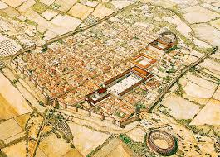
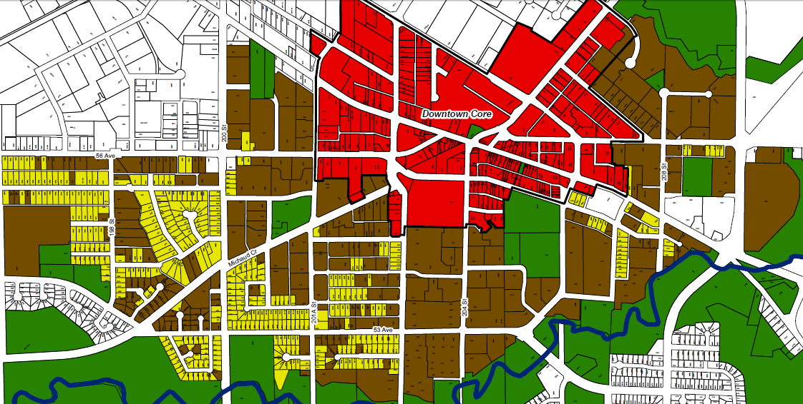
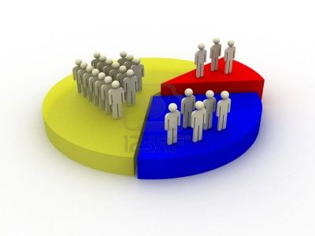
Urbanism?
'Urban' originates from the Latin word 'urbs,' which means 'city' or 'town,' and has been in use since the 17th century.​​
The term "urban" is employed with dual meanings.
Urban Area
'City' and 'town' are often used interchangeably and refer to populations engaged in non-agricultural or non-primary sector activities within a given area.​
Demographic
Sociological
In demographic terms, the emphasis lies in examining the population's size, density, and the predominant occupation among adult males which is non-agricultural.
From a sociological perspective, the attention is directed towards diversity, lack of personal connection, mutual reliance, and the standard of living.
Countries determine urban settlements based on population concentration with a minimum threshold size in a specific area.​
'Towns' and 'cities' form a functionally interdependent hierarchy, with larger cities incorporating more functions and being more self-contained.​
When explaining about urbanism -Max Weber (1961) and George Simmel (1950) have stressed on dense living conditions, rapidity of change and impersonal interaction in urban settings.
Urban areas are defined considering socio-economic dimensions alongside demographics (Pacione 2009).​
​
Pacione, M. (2009). Urban Geography: A Global Perspective. London: Routledge.

Slide 3
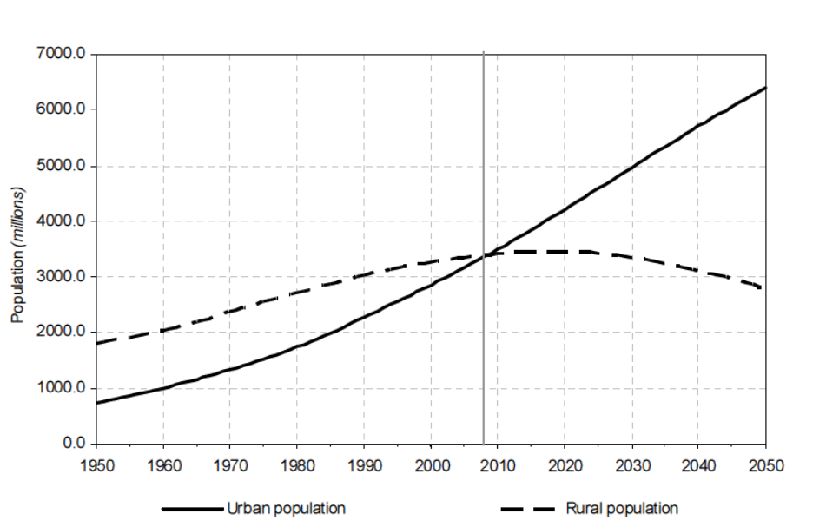
What is Urbanization?
Urbanization refers to the transition of populations from rural areas to cities, involving shifts from agriculture to urban activities like trade, industry, and management. This process expands the interrelationships within a population's habitat and reflects on populations behaviour. Notably, the growth of urban population and non-agricultural urban centres are key aspects. Urbanization has accelerated significantly with industrialization and increased urban growth, shaping contemporary life (Hawley, 1978).
Changing from agriculture to other pursuits common to cities
Changes of behavior patterns
Moving to cities
Hawley, A. H. (1978) "Urbanization as process," pp. 3-26 in D. Street (ed.) Handbook of Contemporary Urban Life: An Examination of Urbanization, Social Organization and Metropolitan Politics.

Slide 4
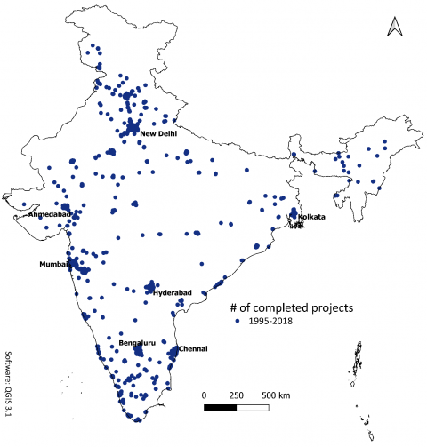
Why do cities exist?
Formation and growth of cities are influenced by complex social, economic, and historical factors. But it is 'clustering' that plays a crucial role in the existence and vitality of cities.
Agglomeration in urban areas offers - efficient trade, cost-effective production, and access to a wide range of services and opportunities. It is a fundamental principle, where the benefits of proximity drive economic and social interactions.
Economic Opportunities
Facilitating Trade (in Goods and Ideas)
Trade and Commerce
Comparison Shopping
Exchange of Ideas and Socialization
Cities as Large Markets
Better Transportation
Cites as nodes of accumulation
Social and Cultural Centers
CLUSTERING/AGGLOMERATION
Innovation and Entrepreneurship
It refers to the spatial concentration or grouping of similar or related entities in a specific geographic area. In the context of urban studies and economics, clustering often involves the gathering of businesses, industries, institutions, or people near one another.
Facilitating Production
Education and Research
Economies of Scale
Proximity to Jobs
Clustering of Firms
Governance and Administration
Healthcare and Services
Facilitating Consumption
Infrastructure and Connectivity
Variety of Services
Economies of Agglomeration
Social Networking and Community
*The benefits that come when firms and people locate near one another
Economies of scale: Economies of scale refer to reduced costs per unit that arise from increased total output of a product.

Slide 5
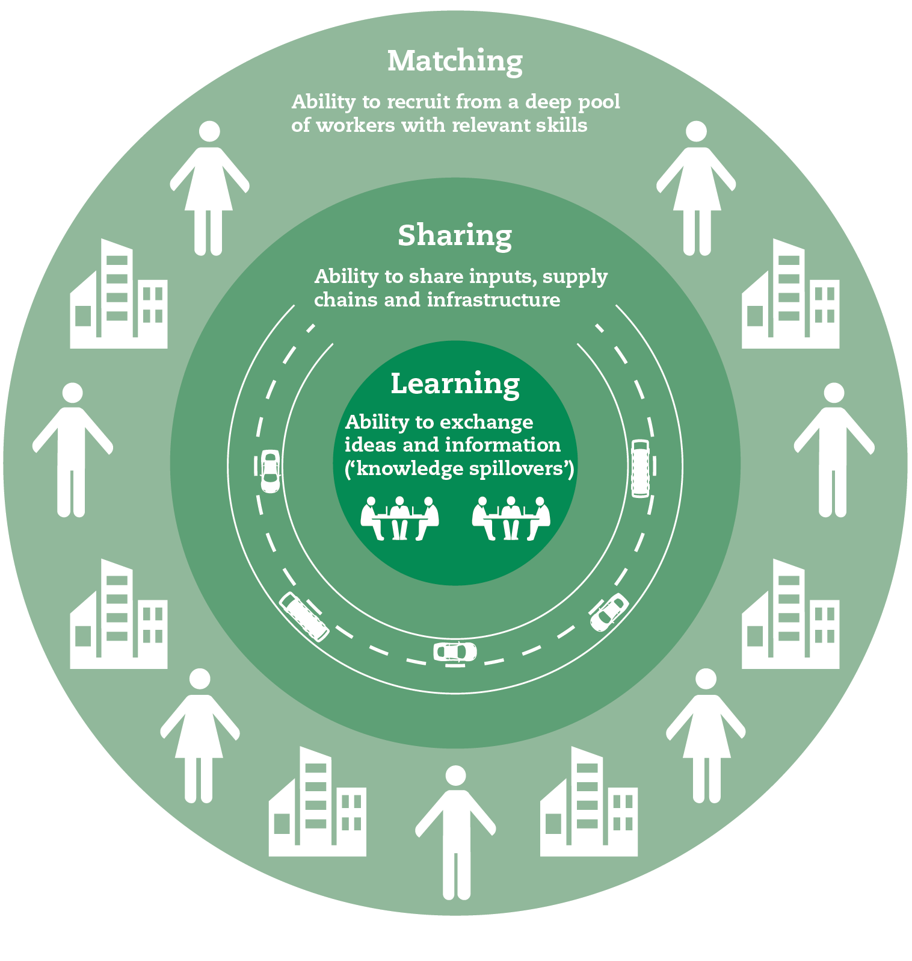
The Role of economics in city formation
Comparative advantage plays a significant role in influencing the specialization and growth of cities.
Gains from Trade: It refers to the ability of individuals, regions, or nations to produce goods or services at a lower opportunity cost compared to others. When regions or groups of people possess different comparative advantages, there are gains from trade.
Specialization: These gains from trade encourage regions where resources are put to specialized use to maximize efficiency.
Economies of Scale in Exchange: It is more efficient to have intermediaries, such as trading firms or marketplaces, that facilitate transactions between buyers and sellers.
Concentration of Trading Firms: Because trading firms can streamline the process of collecting and distributing goods, they tend to concentrate in areas that facilitate these activities. Hence, forming trading cities.
It is the unique strengths or advantages that a particular region or locality possesses, making it well-suited for certain economic activities or functions.

Slide 6
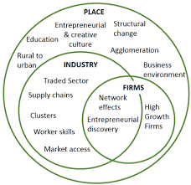
The Role of economics in city formation
Economies of Scale in Production describes the cost advantages a business or organization can achieve as it increases the scale or volume of its production. In simpler terms, it means that as a company produces more of a particular good or service, the average cost per unit of production decreases.
Resource Concentration: Given the cost advantages associated with economies of scale, it makes sense to concentrate resources, including labor and capital, in one location, typically a factory or manufacturing facility.
Proximity of Workers: Workers tend to locate near these production facilities to reduce transportation costs and increase efficiency.
Formation of Cities: As a result of these factors, cities emerge. These cities are characterized by the concentration of factories and production facilities, often centered around a specific industry or manufacturing sector.
Hoselitz, B. F. (1955). The City, The Factory, and Economic Growth. The American Economic Review, 45(2), 166–184. http://www.jstor.org/stable/1823550

Slide 7
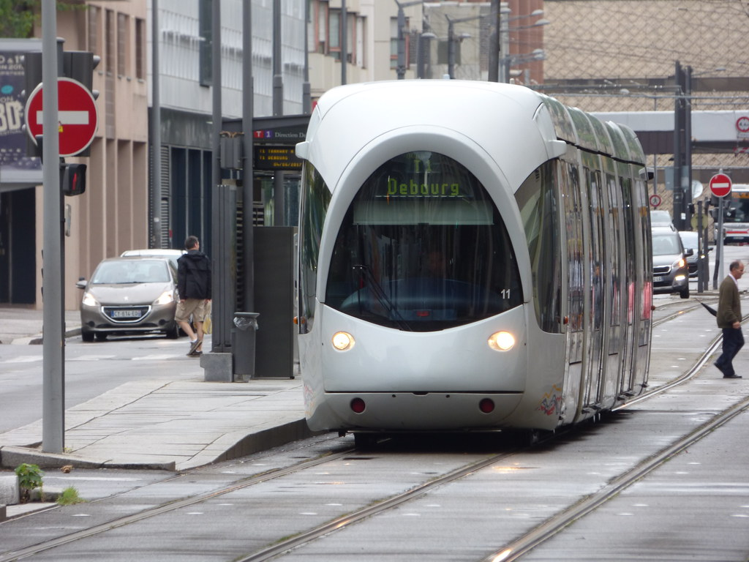
Externalities
The unintended and often indirect consequences of urban activities that affect individuals, groups, or the environment without being reflected in market prices.
Externalities can be positive or negative and typically arise due to the interdependence of urban systems and the shared use of resources and spaces within a city.​
Example of Positive Externalities in cities
Public Parks: Well-maintained public parks in a city provide recreational opportunities, green spaces, and improved air quality for residents, benefiting the community as a whole.
Public Transportation: Investment in efficient public transportation systems can reduce traffic congestion and pollution, benefiting both users and non-users.
Education: High-quality urban schools can lead to a more educated and skilled workforce, benefiting the entire city by attracting businesses and contributing to economic growth.
Cultural Institutions: Museums, theaters, and cultural events contribute to a vibrant cultural scene that can enhance the quality of life and attract tourists.

Slide 8
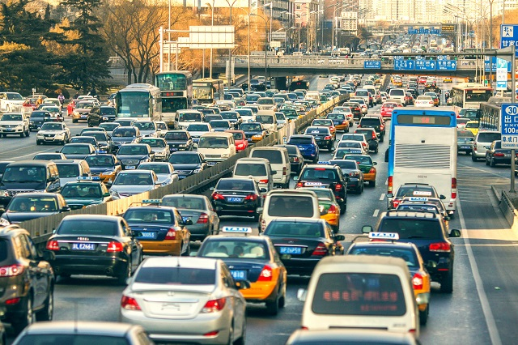
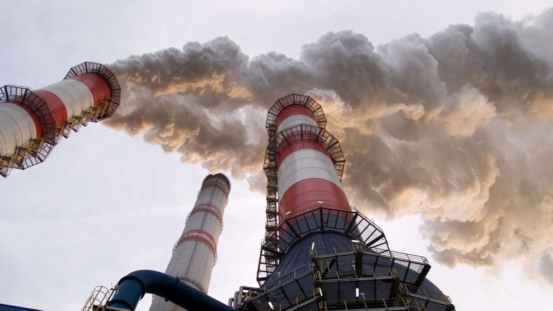
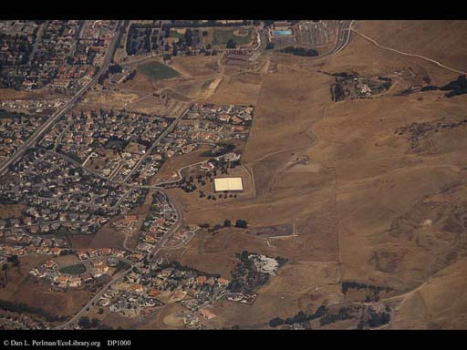
Externalities
The unintended and often indirect consequences of urban activities that affect individuals, groups, or the environment without being reflected in market prices.
Example of Negative Externalities in cities
Noise Pollution: Urban activities, such as construction and traffic, can generate noise that disturbs residents in nearby areas.
Urban Sprawl: The expansion of urban areas into previously undeveloped land can lead to habitat destruction and increased demand for resources, affecting the natural environment.
Traffic Congestion: Increased urban traffic results in longer commute times and air pollution, negatively affecting the well-being of residents and the environment.
Air Pollution: Industrial and vehicular emissions can lead to poor air quality, posing health risks for urban populations.

Slide 9
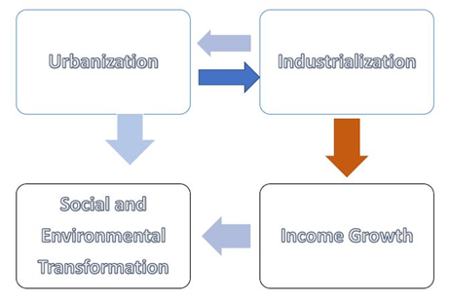
Growth and Structural Transformation
Urbanization is a consequence of economic development, and urbanization rates are used as indicators of income per capita.
Economic development involves a transition from agriculture to manufacturing and services, leading to a migration of labor from rural to urban areas.
This shift in economic activity can be attributed to two main factors:
"Push" factors, driven by improvements in agricultural productivity that encourage labor to move into urban jobs.
"Pull" factors, influenced by enhanced productivity in non-agricultural sectors, which attract labor to urban regions.

Slide 10
City Typologies
The significance of cities in the global or regional economy is not solely determined by their economic size but is also closely tied to their specific roles.
Lo and Marcotullio in their work published in 2001 (pages 97-106) identified four categories of major cities in the Asia and Pacific area based on their roles:
1
Post-industrial capital-exporting cities: Tokyo and Seoul stand out as hubs hosting numerous headquarters of transnational corporations, multinational banks, and producer services. These cities serve as global and regional command-and-control centers.
3
Entrepôt or boundary-less cities: Hong Kong, China, and Singapore serve as pivotal points within extensive cross-border economic regions, encompassing the Hong Kong-Pearl-River Delta-Fujian-Taiwan Province of China region and the Singapore-Johore-Riau growth triangle.
2
Industrial cities: Bangkok, Jakarta, and Manila continue to be manufacturing hubs for the region and the world. This is primarily due to substantial foreign direct investments in export-oriented manufacturing within these urban centers.
4
Amenity cities: Sydney has transitioned to a post-industrial economy, capitalizing on its integration into the regional economy and offering a substantial array of amenities designed to draw investments and economic activities.
Fu-Chen Lo and Peter J. Marcotullio, “Globalization and urban transformations in the Asia Pacific region,” in Fu-Chen Lo and Peter J. Marcotullio, (Eds), Globalization and the Sustainability of Cities in the Asia Pacific Region, Tokyo: UNU Press, pp. 97-106.

Slide 11
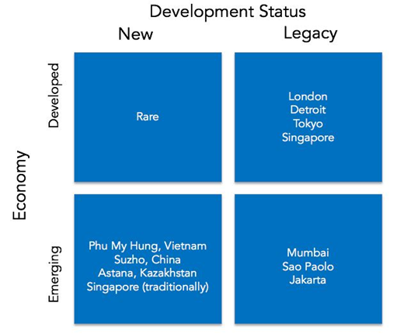
City Typologies
Cities exhibit inherent differences, and even the most groundbreaking strategy can never attain widespread influence.
According to Harvard Business Review cities can be divided into four distinct categories
Developed Economy, New City
Developed Economy, Legacy City
Emerging Economy, New City
Emerging Economy, Legacy City

Slide 12
City Typologies
According to Harvard Business Review cities can be divided into four distinct categories
Developed Economy, Legacy City
Emerging Economy, Legacy City
Emerging Economy, New City
Slow demographic growth
zero-sum situation
High GDP
Innovations takes place
where entrepreneurs can create solutions that improve quality of life — without added government expense
Any intervention in a legacy city must dismantle something that existed before
Fast-growing populations and severe congestion
Opportunity to create value by improving efficiency and livability as there is a market of customers with cash to pay for these benefits.
Focus on public-private partnerships (PPP)
Most physical and institutional structures are already in place in these megacities
High population growth
High growth rates in GDP per capita
Demographic and economic tailwinds that help to boost returns
The urban areas have few existing physical or social structures to dismantle as they grow, hence obstacles for new development.
Developed Economy, New City
Such cities are very rare
“new cities” in the developed world are large, integrated real-estate developments with an urban theme, usually near a true municipality
These cities provide employment opportunity for the existing municipality

Slide 13
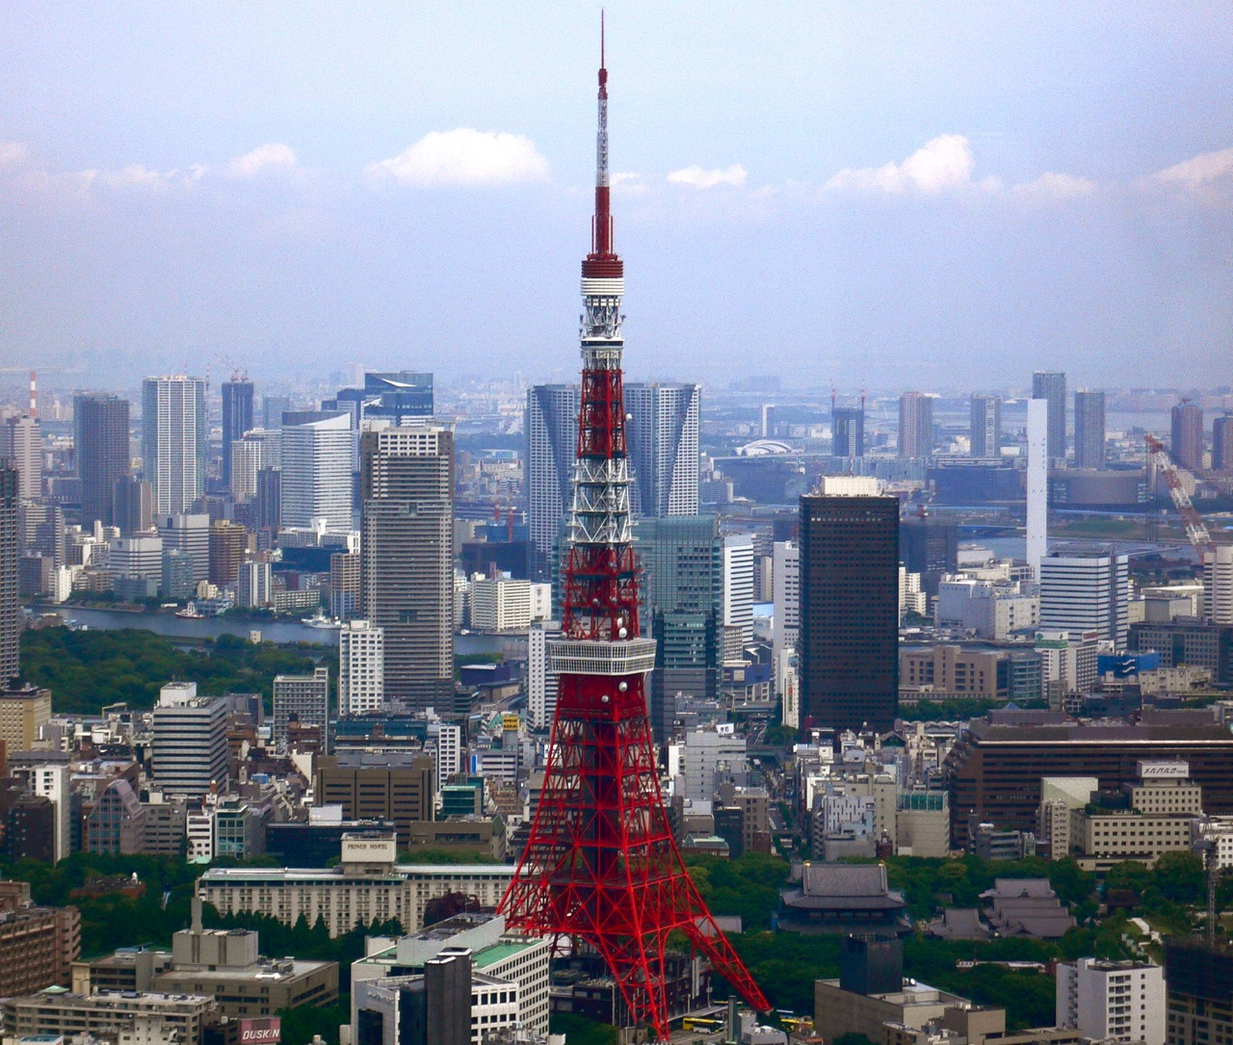
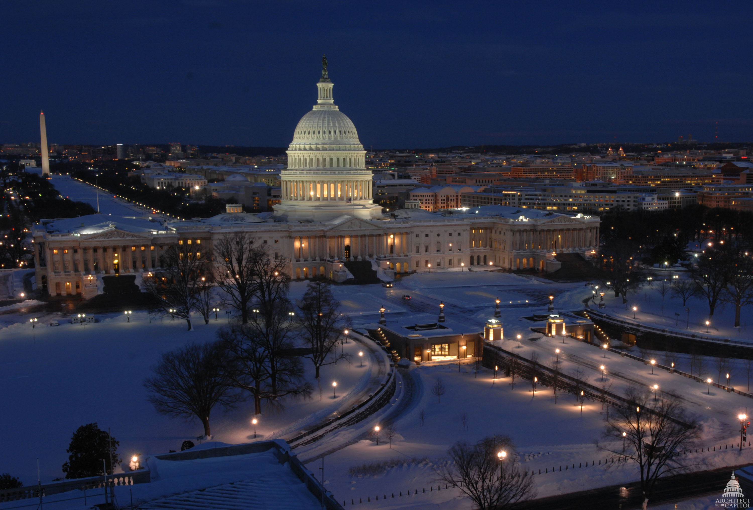
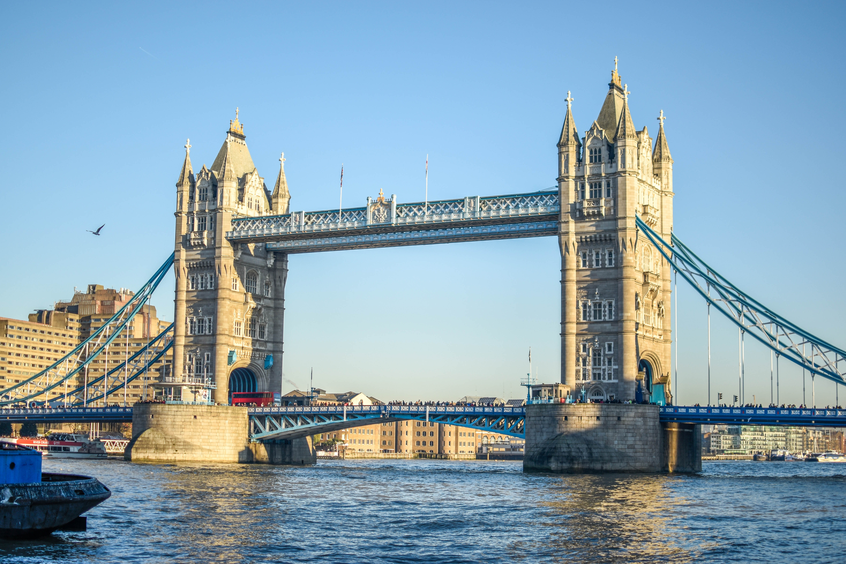
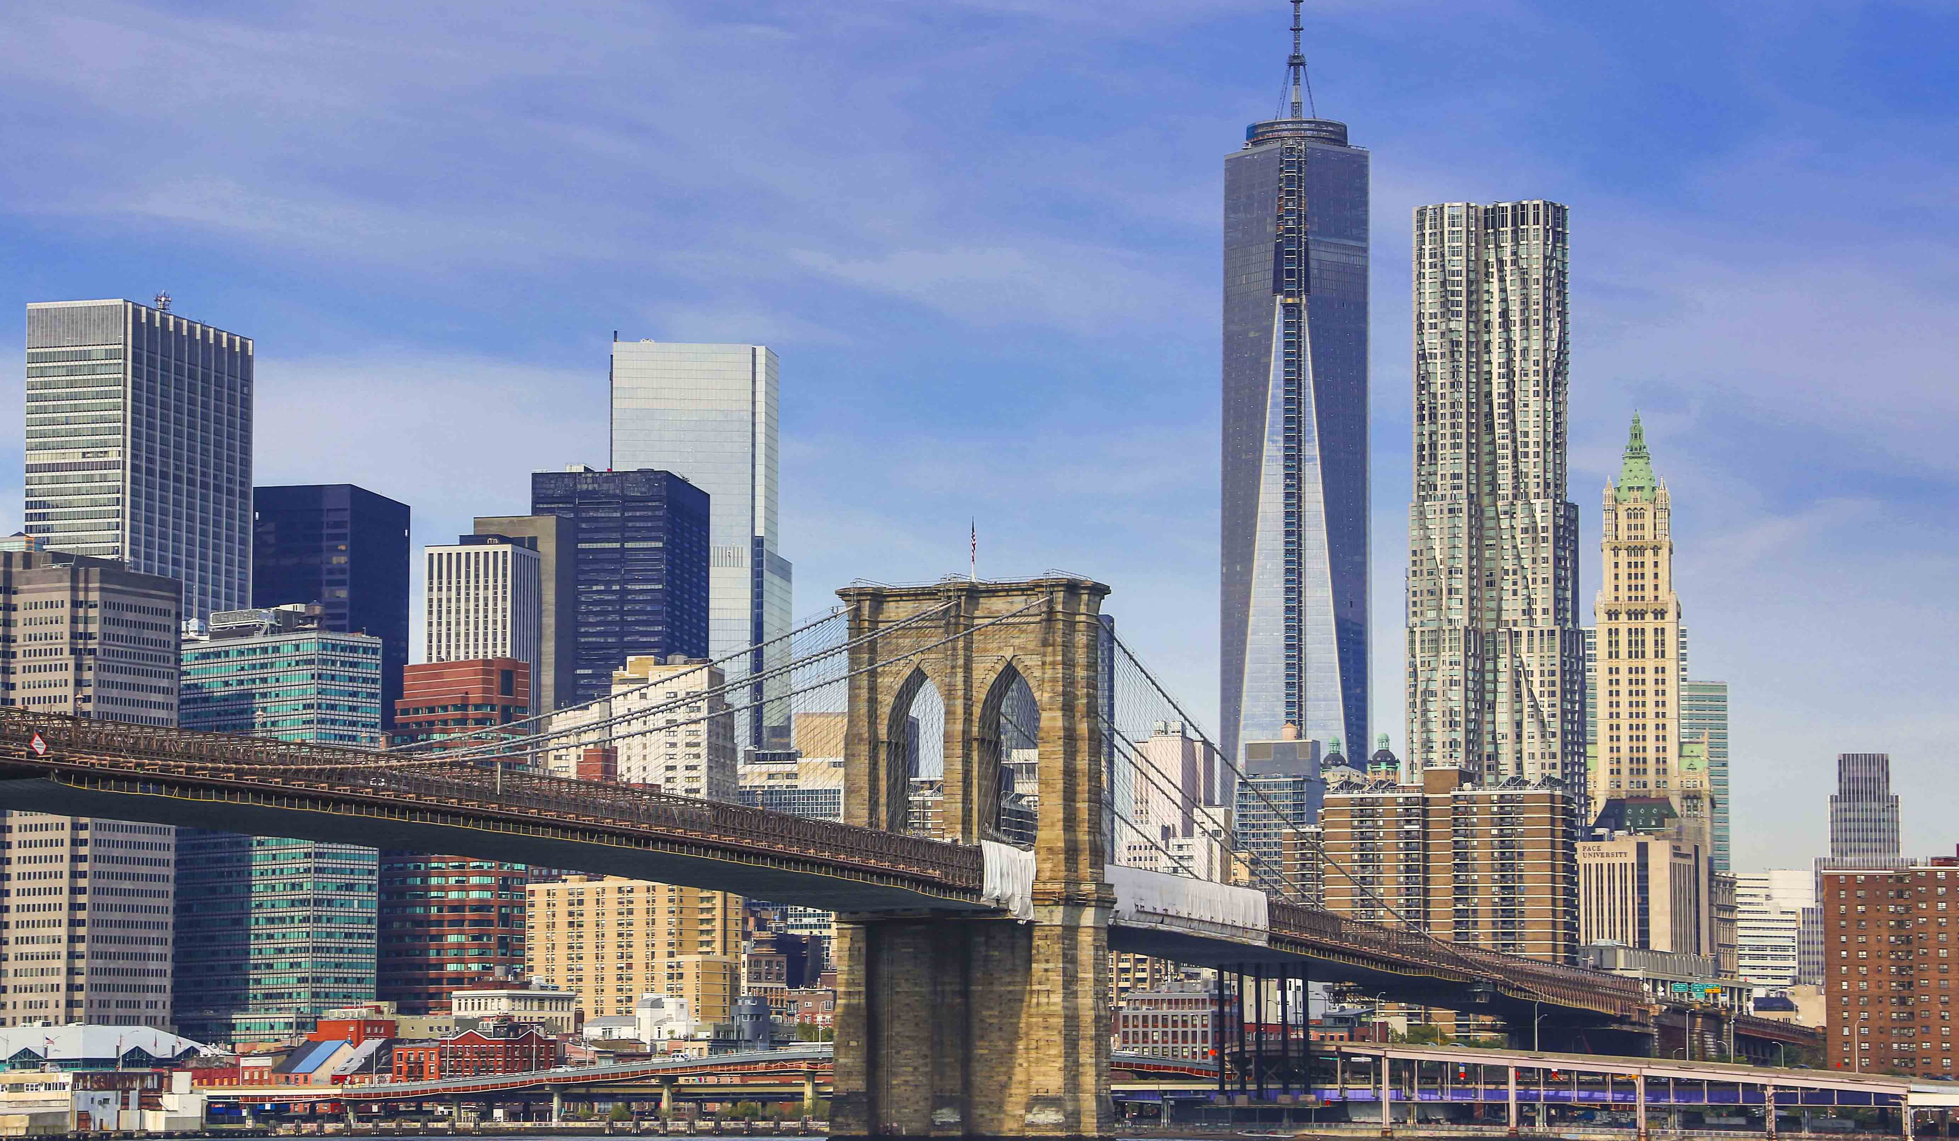
City Typologies
Type of cities based on its size and function:
Global cities-
Epicenters of human activity that help drive the global economy
They are also center of cultural innovation, trade and commerce
very high density in terms of buildings and population
Examples- New York, London, and Tokyo
National cities-
These cities are political, commercial, or cultural capitals
Most resemble global cities but operate at a smaller scale.
Washington, D.C., is a center for US government
Regional cities
Smaller in size and sphere of influence than national cities
The are the traditional cores of local regions. Eg : Cleveland
The 4 types of cities and how to prepare them for the future (2017) Harvard Business Review. Available at: https://hbr.org/2016/01/the-4-types-of-cities-and-how-to-prepare-them-for-the-future

Slide 14
City Typologies
PRIMACY/ PRIMATE CITY
A primate city is a major city that works as the financial, political, and population center of a country and is not rivaled in any of these aspects by any other city in that country.
Normally, a primate city must be at least twice as populous as the second largest city in the country.
The capital becomes the dominant city controlling trade between smaller urban areas as well as with international markets.
It becomes a symbol of the nation’s achievements.
The large share of national population reinforces their concentrated wealth, power and status.
The phenomenon is present in many small sized countries such as: France (Paris), Greece (Athens), Iraq (Baghdad), Thailand (Bangkok)
4
3
7
6
City 1
2
5
Twice as populous as the second largest city

Slide 15
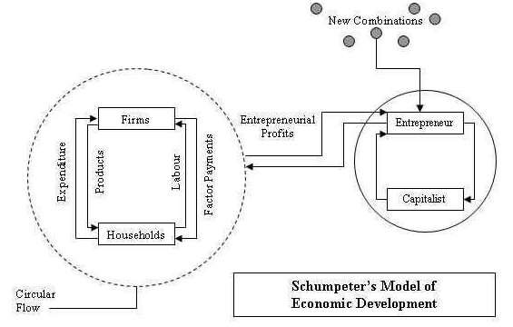
Model of Economic Growth
Schumpeter’s Theory of Economic Evolution
Schumpeter assumes a perfectly competitive economy which is in stationary equilibrium. In such a state, there is perfect competitive equilibrium, no profits, no interest rates, no savings, no investments and no involuntary unemployment.
This equilibrium is characterized by the term “circular flow”, continues to repeat itself every year.
According to Schumpeter economic development is "spontaneous and discontinuous change in the channels of circular flow."
Development consists of carrying out of new combinations of possibilities in stationary state. Thes possibilities come in the form of INNOVATIONS.
INNOVATION consists of:
Creation of a new product
The use of new technologies of production,
Use the new organization of production,
Opening new markets and sources of raw materials

Slide 16
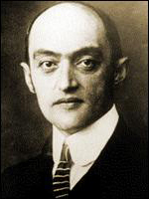
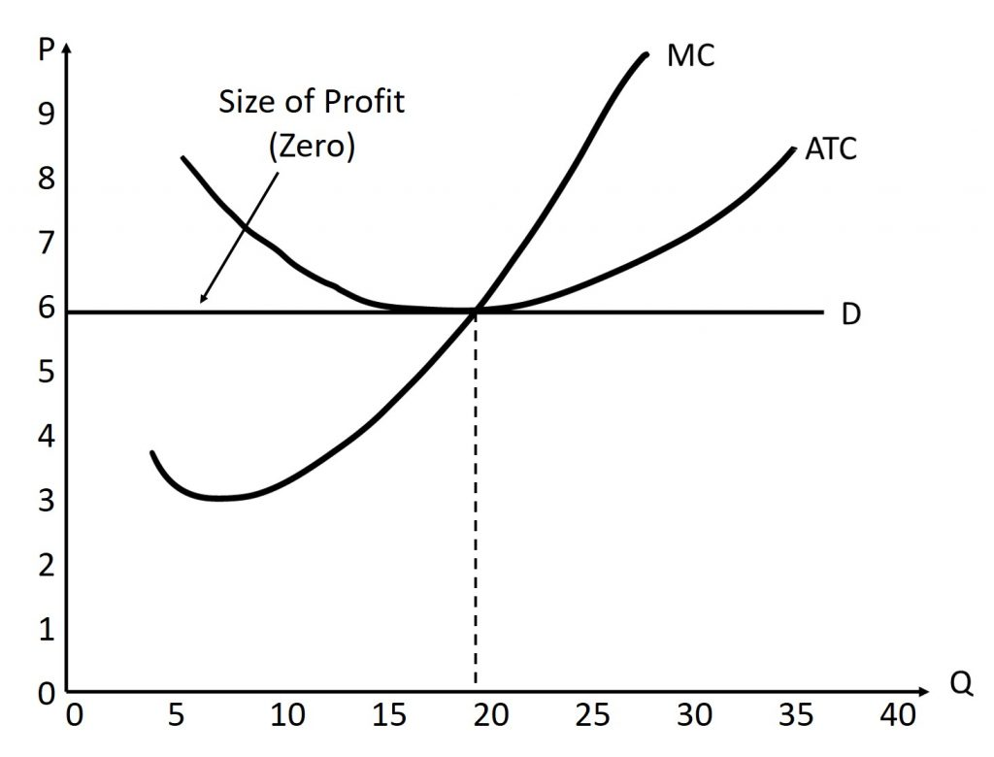
Model of Economic Growth
Schumpeter’s Theory of Economic Evolution
Did you know?
He used to call dismantling of long term practices as CREATIVE DISTRUCTION
Development in his theory was - An ENTRAUPRENURE is an economic entity, which is different from the capitalist and the worker. It has a 'special gift', a character feature of human nature which does not depend on class or social status.
This type of character includes the following features:
Example: Internet
Entrepreneur innovated to earn profits. Under competitive equilibrium, the price of each product just equals its cost of production and there is no profit. Profits arise due to dynamic changes resulting from an innovation and exist till the innovation becomes general.
Self-reliance
Preference for risk
The value of own independence
Focus on own opinion
The need to achieve success
Desire for innovation
PROFIT
New combination of products
New methods of production
Expand new markets
New forms of management

Slide 17
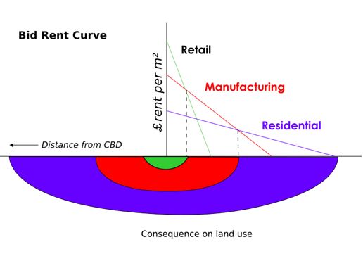
Location Theory
The analysis of land use patterns has long been one of geography’s basic concerns.
Ever thought why Connaught Place in Delhi or any other city center is hustling bustling with people and tall commercial buildings?
BID-RENT CURVE
(Bidders bidding to get access to the land in exchange of rent)
For Retail
The theory is based on microeconomics concept and is taken from the work of Alonso (1964) & Muth (1969).
Land use pattern
Dependent
Low Transportation Costs Near Central Business District (CBD):
Proximity to the CBD results in lower transportation costs for firms.
Businesses situated near the CBD find it cost-effective to operate due to reduced expenses associated with transportation.
Higher Costs with Distance:
As one moves farther away from the CBD, transportation costs tend to increase.
Firms and retailers located at greater distances from the CBD face higher transportation expenses, which can affect their profitability.
Value of Central Location:
Companies near the CBD are willing to pay premium prices for land in these central areas.
They do so because being centrally located helps minimize their transportation costs, making it economically advantageous.
Land Value
Accessibility

Slide 18
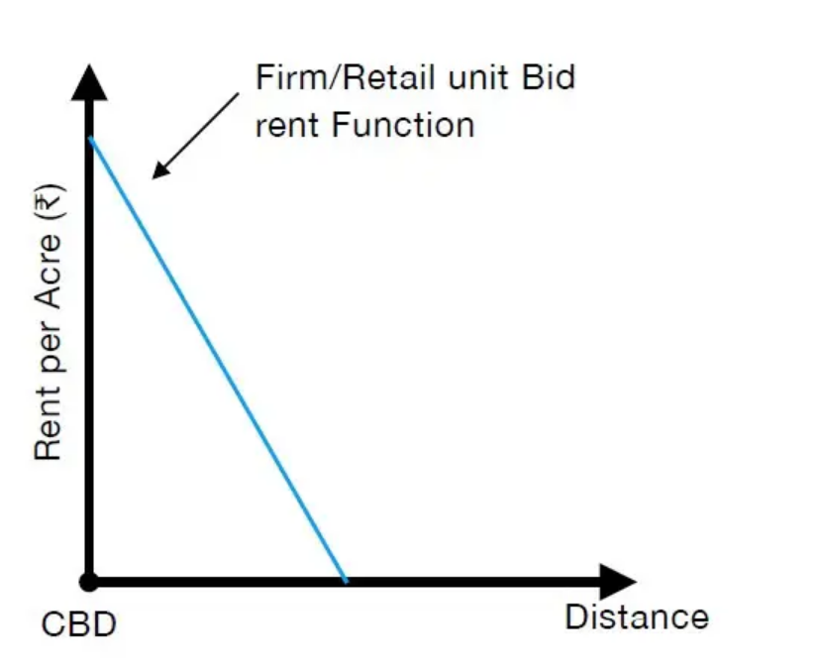
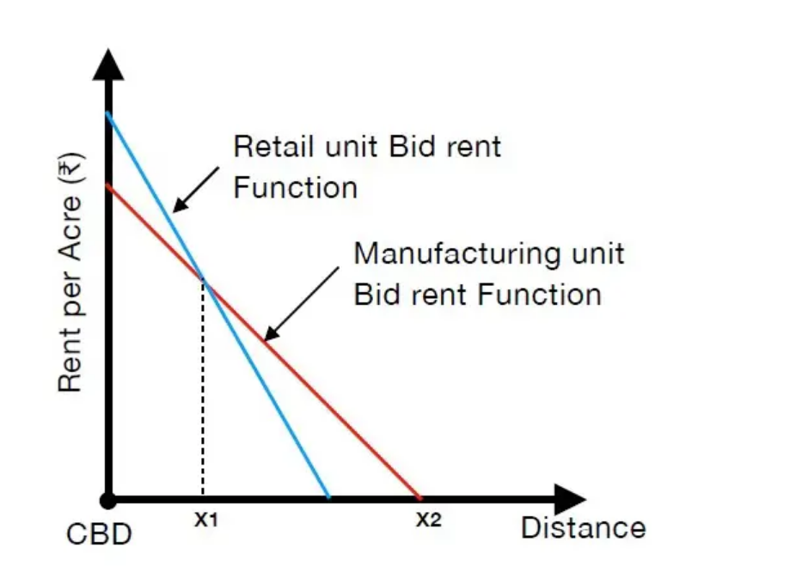
Location Theory
BID-RENT CURVE
For Manufacturers:
Manufacturers rely on access to markets to sell their products but can draw labor from a wider geographical area. They require larger land holdings to set up production facilities and warehousing.
The bid rent function for manufacturing tends to have a flatter slope. Manufacturers prioritize larger land holdings for their operations and can afford to be located at somewhat greater distances from the city center because their market access is less location-sensitive than that of retailers.
Impact on Land Prices:​
Businesses situated at more distant locations are less willing to pay high prices for land.​
This reluctance is due to the added transportation costs they would incur and the potential loss of accessibility to customers as they move away from the CBD.​
​
the intersection of the two bid rent functions, point X1 defines the point at which land use changes from retail activities to manufacturing activities.

Slide 19
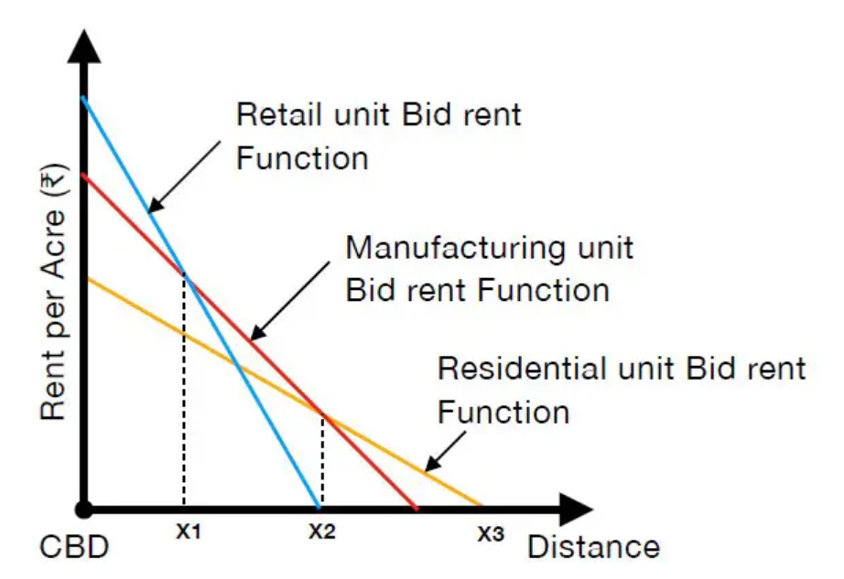
Location Theory
BID-RENT CURVE
For Residential
Location of Households:
Households tend to settle in various locations within a city or region.
The choice of location for households is influenced by factors different from those affecting industrial or commercial properties.
Accessibility and Attractiveness of Land:
The attractiveness of land to industries diminishes as one moves farther away from the city center.
Distant land areas typically lack convenient access to markets and transportation infrastructure.
Household Land Purchase:
Households often choose to purchase land in areas that are farther from the urban core.
These locations are favored by households because they do not rely heavily on factors like proximity to markets and transportation, and land tends to be more affordable there.
Assumptions of the model
All land is privately owned & there is evenly distributed population across the city
All individuals participating in the bidding process possess complete knowledge regarding the expenses associated with different locations.
There is a Linear Functioning of Transportation cost to that of the Distance

Slide 20
Location Theory
The analysis of land use patterns has long been one of geography’s basic concerns.
Trade-off Model:
Trade-off Model by Muth (1969):
Muth's trade-off model explains the prevalence of high-quality housing on the outskirts of a city.
It focuses on the delicate balance between two factors: access to central locations and the space desired by households.
Space Versus Access/Travel Cost Minimization Theory (Balchin, Bull & Kiev, 1995):​
This theory, proposed by Balchin, Bull, and Kiev in 1995, can also be termed as the minimization of space versus access or travel costs.​
It suggests that when the costs associated with commuting to work are extremely low or nonexistent, households are willing to pay the highest rents or property prices for their accommodation.​

Slide 21
Thank You!
Shiren Pandita
Area Convenor and Research Associate
The Energy and Resources Institute
Email Id: shiren.pandita@teri.res.in

