Slide 1
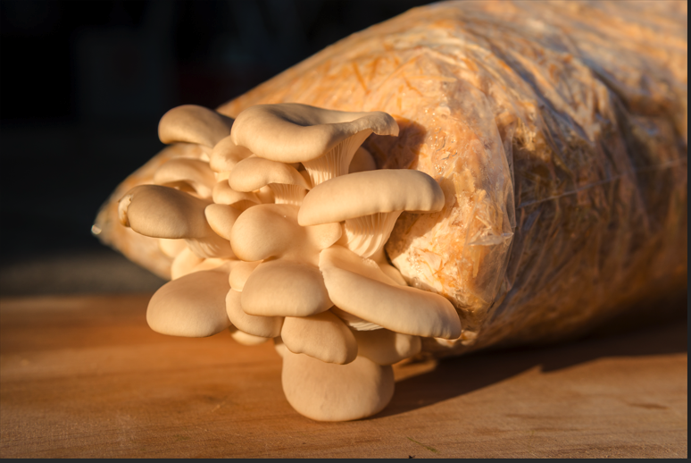
Prepared By: Dr. Mithu Dey
Reviewed By: Dr Ninad Mohan Marathe

Slide 2
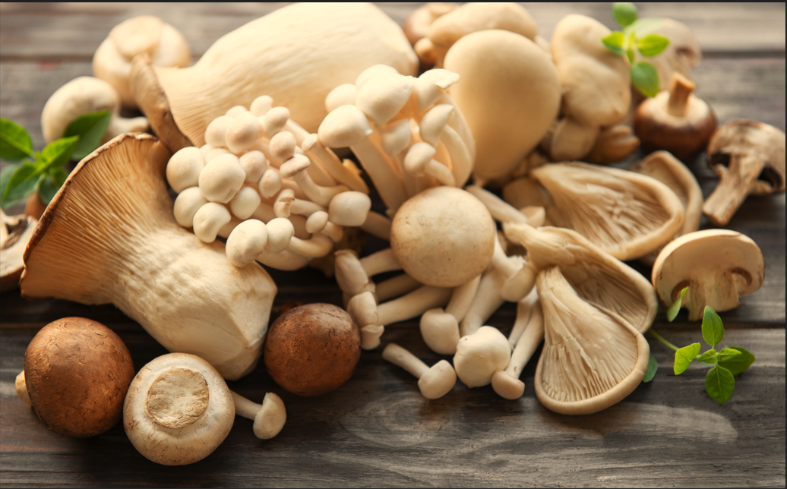
Mushroom : A Super Food

Slide 3
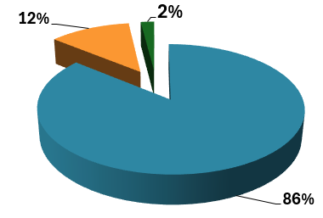
Introduction to Mushroom
Mushrooms are the most fascinating group of fungi, and human beings have been consuming them for thousands of years due to their valuable nutritional and medicinal properties.
Total Number of Mushroom Species
Mushroom species in the world - 14000
Edible Mushroom species in the world - 2000
Edible Mushroom species found in the India - 283

Slide 4
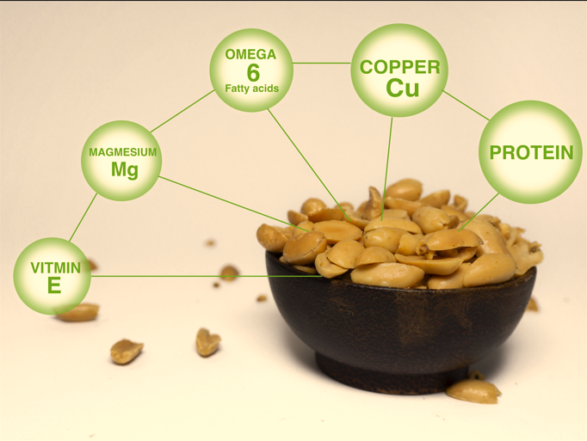

Slide 5
Vitamins:
3. Protein:

Slide 6
4. Fiber:
Both soluble and insoluble fiber
5. Antioxidants:
Ergothioneine and Glutathione
6. Polysaccharides:
Beta-glucans
7. Water
Have a high-water content

Slide 7
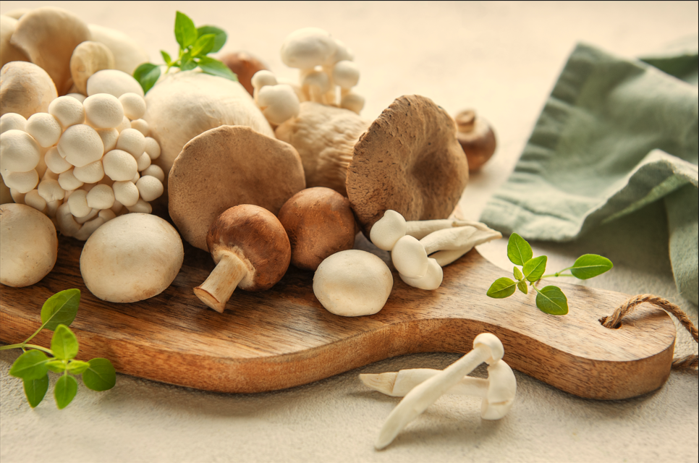
Chop rice straw to 5 cm or smaller length.

Slide 8
1. Boosting a healthy immune system.
2. Protect brain health.
3. High selenium content reduces the risk of chronic diseases like cancer and heart disease.
4. Cut down on extra calories from the diet.
5. Aids in weight management and reducing obesity.
6. Regulating blood sugar and blood pressure.
7. Helps lower cholesterol levels.
8. Improve digestion and overall gut health.
9. Promoting bone health.

Slide 9
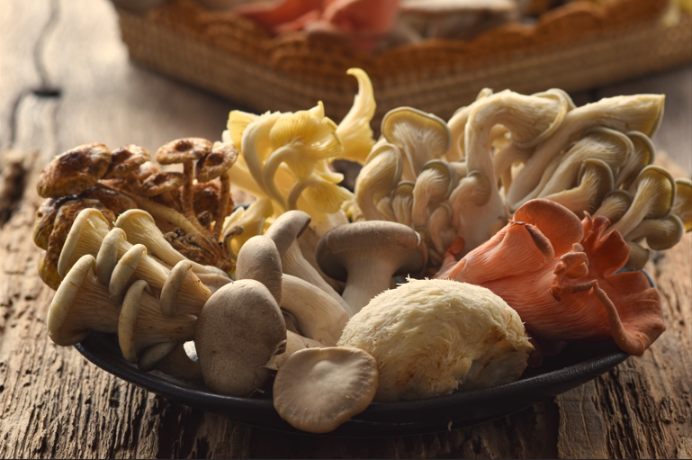
Chop rice straw to 5 cm or smaller length.
Some Common and Edible Mushrooms

Slide 10
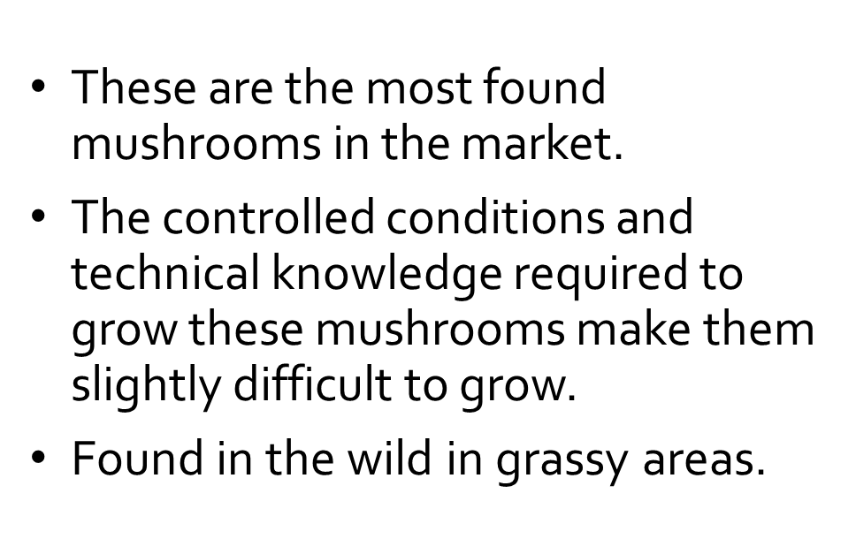
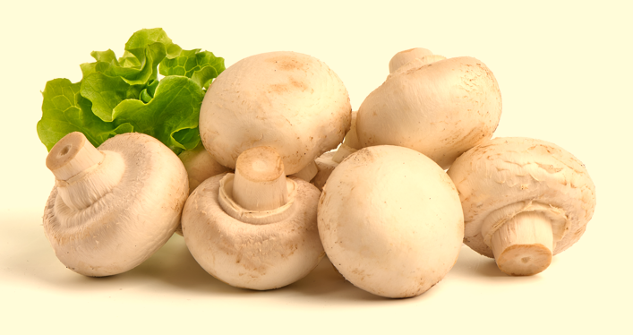
1. White button mushrooms (Agaricus bisporus)
White button mushroom

Slide 11
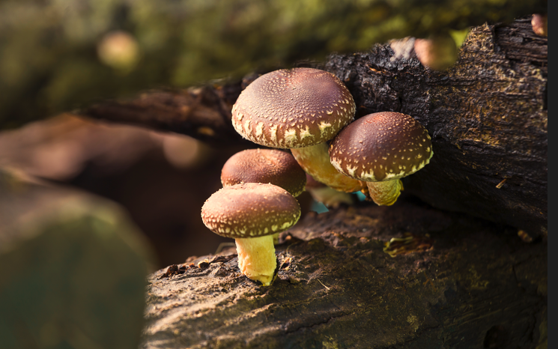
2. Shiitake mushroom (Lentinula edodes)
Takes 6-12 months to colonize logs and produce mushrooms fully.
Grows on hardwood logs or sawdust-based substrates.
Contains polysaccharides like lentinans that help strengthen immunity
Shiitake mushroom

Slide 12
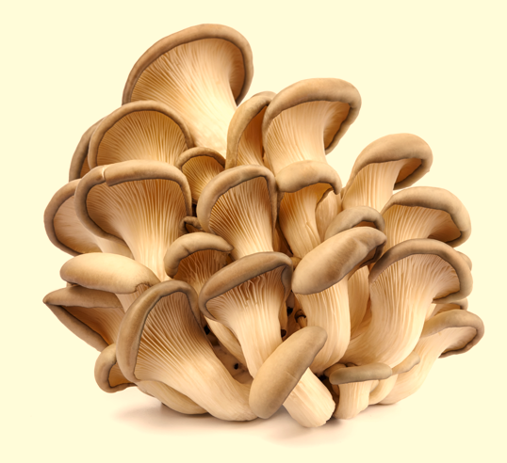
3. Oyster mushrooms (Pleurotus sp.)
Easiest to cultivate and requires low-cost technology.
It grows easily on a variety of Agri-waste.
High nutritional value.
We’ll talk about this in detail in a bit
Oyster mushroom
Other common edible mushrooms are Lentinus, Auricularia, Grifola frondose, Flammulina, Tuber, Morchella, and Tremella.

Slide 13
Value–added products of Mushroom
Some value-added products of mushrooms are
Mushroom Murrabba
Mushroom Soup Powder
Mushroom Papad
Mushroom Nuggets
Mushroom Paste/ Sauces
Dried Mushroom Powder
Mushroom Snacks/ Biscuits
Mushroom Pickles
Mushroom Chips
Mushroom Candy
Mushroom plant-based meat substitute

Slide 14
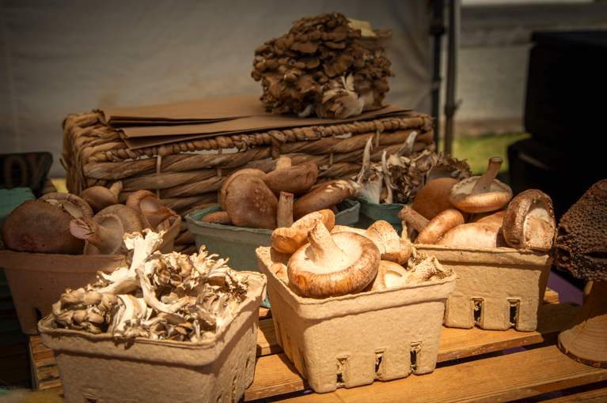
Chop rice straw to 5 cm or smaller length.
Why Mushroom cultivation is important?

Slide 15
Rich source of essential nutrients.
Contributes to food security.
Used in traditional medicine for their medicinal properties.
Composting organic agricultural waste and increasing soil fertility.
Requires less land, water, and energy than traditional farming.
Provides a good source of income for small-scale and resource-poor farmers.
Relatively short growth cycle, allowing for multiple harvests throughout the year.
Requires relatively low capital investment than traditional farming.
Supporting agroecological practices and enhancing biodiversity.

Slide 16
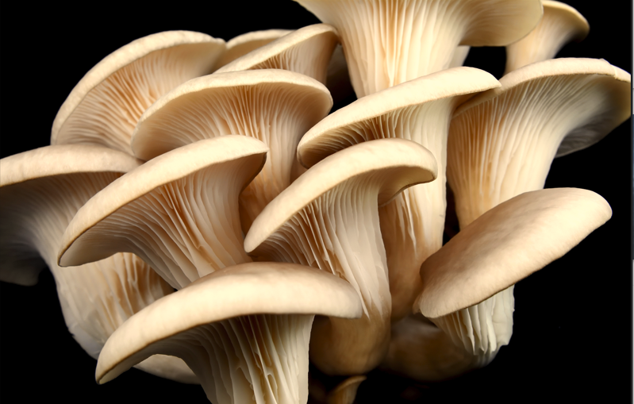
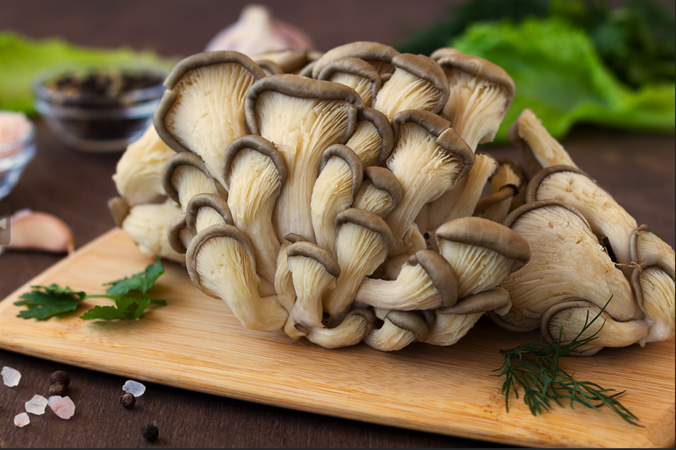
Oyster mushrooms (Pleurotus ostreatus)
Popularly known as ‘Dhingri’ in India

Slide 17
Oyster mushrooms (Pleurotus ostreatus.)
Oyster mushrooms, the common name for the species Pleurotus ostreatus.
Pleurotus ostreatus was first cultivated in Germany as a subsistence measure during World War I and is now grown commercially around the world for food.
They are widely and most easily cultivated edible mushrooms after button mushroom and shiitake mushroom.
Grow naturally on and near trees in temperate and subtropic forests worldwide.

Slide 18
The ideal temperature range is 20-33°C and the preferred pH range is 6.5-7.0 for oyster mushroom cultivation.
Consumption of oyster mushroom extracts lowers cholesterol levels, an effect linked to their content of beta-glucans.
A total of 17 amino acids, including all the essential amino acids, qualitatively identified in oyster mushrooms.
Therefore, Oyster mushrooms are widely cultivated and consumed worldwide for both culinary and medicinal purposes. Adding oyster mushrooms to a cereal diet might aid in overcoming the lack of lysine, an essential amino acid.

Slide 19
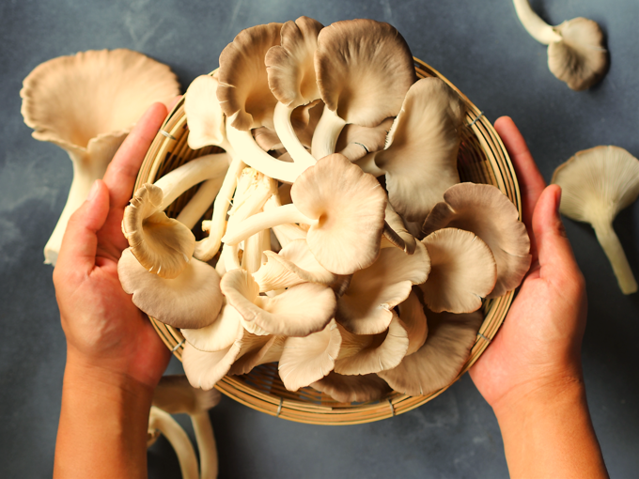
Nutritional composition of oyster mushroom
Calories | 28
Sodium | 15.5mg
Fat | 0.3g
Carbohydrates | 5.2g
Fiber | 2g
Sugar | 0.95
Protein | 2.9g
Niacin | 4.27mg
Potassium | 361.2mg
Vitamin B2 | 0.3mg
Vitamin B3 | 4.3mg
Vitamin B5 | 1.1mg
# Oyster mushrooms are a low-calorie, fat-free, fiber-rich food high in several vitamins and minerals such as phosphorus, copper, and niacin.

Slide 20
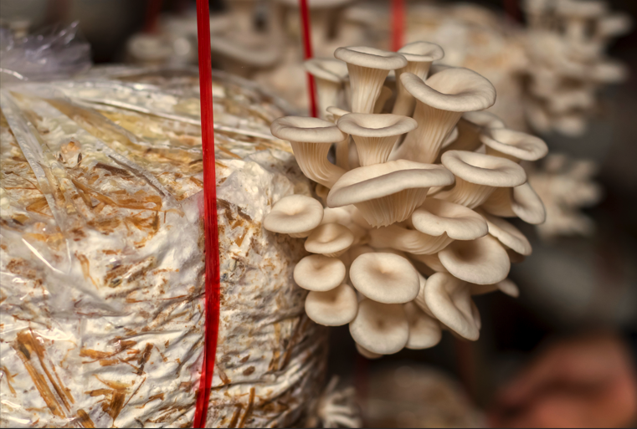
Oyster Mushroom Cultivation
Oyster Mushrooms Method of cultivation

Slide 21
Well-grown various substrates like paddy straw, maize stalk/cobs, vegetable plant residues etc.
Paddy straws are cheap, easily available, and widely used in India.
Paddy straw should be fresh and well-dried combined with various agricultural wastes.
Step 2: Paddy Straw Soaking Process
Chop straw into 3-5 cm pieces.
Soak in fresh water for 8-16 hours.
Soak maize stalks/cobs for 24-48 hours.
Drain excess water on the raised wire mesh frame.

Slide 22
Step 3: Sterilization or Pasteurization
Sterilization can be done in two ways
Pasteurization
Boil water in a wide mouth container.
Fill wet substrate in a bag or basket.
Dip bag in hot 80-85°C water for 10-15 minutes.
Press bag to prevent floating and drain excess hot water for reuse.
Maintain hot water temperature at 80-85°C for all sets.
(b) Sterilization by Chemicals
Use 90 litres of water in a 200 litre drum and steep 10 kg of paddy straw.
Mix 125ml of formaldehyde and 7g of Baistain in 10 litres of water.
Pour solution into drum and cover drum with polythene sheet.
Remove straw after 12 hours.
Spread the pasteurized or chemically sterilized straw on neat and clean cement flooring or raised wire mesh frame, inside the bag filling and chamber.

Slide 23
Step 4: Pasteurized Substrate for Spawning
Pasteurized substrate should be room temperature and have a moisture content of about 70%.
Polythene or polypropylene bags can be used for cultivation.
Spawning can be done in layer or through spawning.
Layer spawning involves filling the substrate in bags, pressing it to a depth of 8-10 cm, and spreading a handful of spawn above it.
Through spawning involves mixing pasteurized straw with 2% spawn and filling bags, then closing the bags for spawn running.
Spawning bags should be stacked clean, closed, and maintained at 15-25° C and 70-85% humidity.
The major nutrients required for oyster mushroom mycelium is Carbon.
Mycelium decomposes the substrate into usable nutrients.
The bags should be fully covered with white mycelium within 20-22 days.

Slide 24
Step 5: Crop Management
Transfer bags to cropping room after 20-22 days.
Remove polythene/polypropylene covers.
Keep open blocks in racks 20cm apart, 60cm wide with 50-60cm gap.
Maintain temperature range of 20°-33° C.
Maintain relative humidity by spraying water twice a day.
Avoid block spraying for first 2-3 days.
Water blocks as small pinheads appear.
Increase watering to 2-3 cm size and stop watering to allow growth.
Step 6: Harvesting
Pluck mushrooms before spore shed.
Scrape outer layer of block after 1st flush.
Initiate 2nd flush after 10 days.

Slide 25
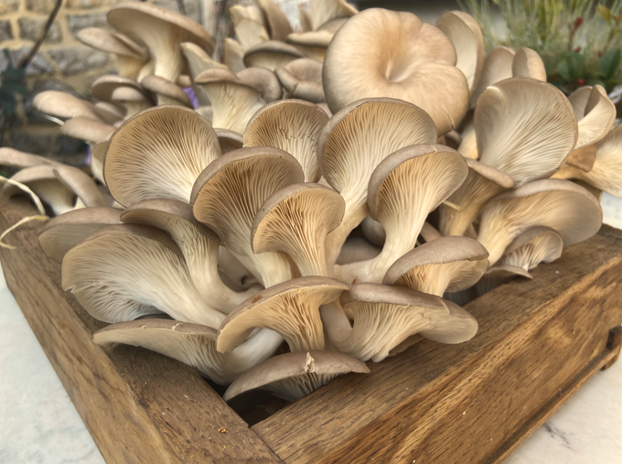
Step 7: Post-harvesting
Clean lower stalk with dry cloth.
Pack in perforated polythene bags for freshness.
Store in refrigerator for enhanced freshness.
Sun dry for 2 days.
Soak dried mushrooms in water for 10 minutes before use.
Oyster Mushroom Growing Conditions
• Grows from cold to temperate, prefers humid conditions.
• Species sustain a wide temperature range.
• Summer species grow from 25-30oC.
• Winter species thrive from 18-22oC with 85-90% humidity.
• 20-25oC temperature is optimal for cultivation.

Slide 26
Chop rice straw to 5 cm or smaller length.
S.No | Summer growing species of Oyster Mushroom | S.No | Winter growing species of Oyster Mushroom
1. | Pleurotus flabellatus (Common name - Strawberry Oyster | 1. | Pleurotus cornucopiae (Common name - Branched Oyster)
2. | Pleurotus membranaceus (Common name - Membranous Oyster) | 2. | Pleurotus fossulatus (Common name - Tree Oyster)
3. | Pleurotus citrinopileatus (Common name - Golden Oyster) | 3. | Pleurotus ostreatus (Common name – Hiratake)
4. | Pleurotus sapidus (Common name - Peppery Oyster) | 4. | Hypsizygusul marius (Common name - Blue Oyster)
5. | Pleurotuseous (Common name - Pearl oyster) | 5. | Pleurotus enyngii (Common name - King Oyster)
6. | Pleurotus sajorcaju (Common name – Houbitake) | 6. | Pleurotus florida (Common name – White Oyster

Slide 27
Challenges in Mushroom Cultivation
Susceptibility to contamination by competing microorganisms. like bacteria, mold, and other fungi.
Managing specific temperature and humidity requirements.
Risk of insects and pests damaging the mushroom mycelium.
Diseases like mushroom molds and bacterial infections affecting mushroom health and yields
Struggles to achieve consistent yields due to environmental conditions.
Unpredictability of the mushroom market, affecting prices and supply.

Slide 28
Precautions in Mushroom Cultivation
Fumigation of rooms with formalin and potassium permanganate.
Hand and leg cleaning before entering dark or crop rooms.
Maintaining strict hygienic conditions inside and on farm premises
Avoiding dust cleaning with a broomstick.
Monitoring temperature and humidity in rooms.
Regular check for contaminated beds.
Avoiding visitors due to pests.
Maintaining hope in mushroom production despite time.

Slide 29
Preservation and Storage of Mushroom
Refrigeration: For moisture, store fresh mushrooms in paper bags.
Avoid Plastic Bags: Use breathable containers like paper bags or perforated containers.
Freezing: Freeze mushrooms after blanching for several months.
Drying: In a cool, dark place, store mushrooms thinly and in an airtight container.
Pickling: Add vinegar and spices for shelf-life extension
Canning: Use mushrooms within a few days of purchase.

Slide 30
Handling: Clean mushrooms gently, avoid water unless necessary.
Storage Duration: Fresh mushrooms last up to 7 days, frozen mushrooms 6-12 months, dried mushrooms 1 year or more.
Common Mushroom Issues Troubleshooting
Contamination: Discard affected substrate.
Low Yield: Ensure correct environmental conditions and substrate preparation.
Dehydration: Increase humidity by misting.

Slide 31
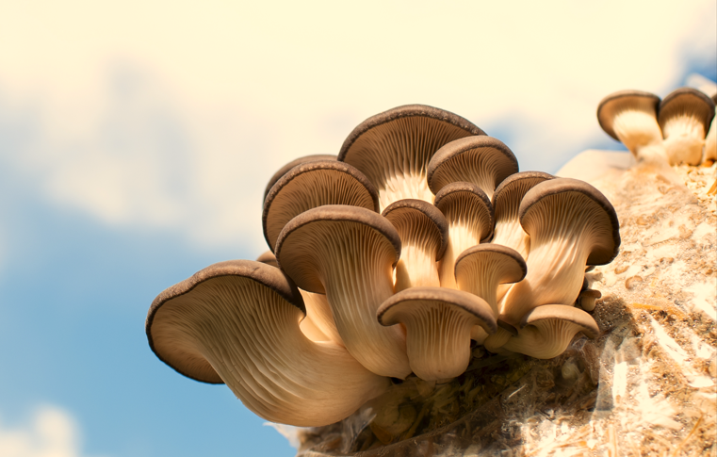
Mushroom cultivation:
Sustainability and Environmental Benefits

Slide 32
Low environmental impact.
Pollution-free and organic.
Minimal energy requirement supports biodiversity.
Require relatively little water to grow.
Helps to absorb carbon dioxide during cultivation.
More resilient to climate-related challenges.
Contributing to waste management by making use of agricultural by-products.
Helps reduce landfill waste and contributes to a circular economy.
Requires no pesticides making cultivation more environmentally friendly.

Slide 33
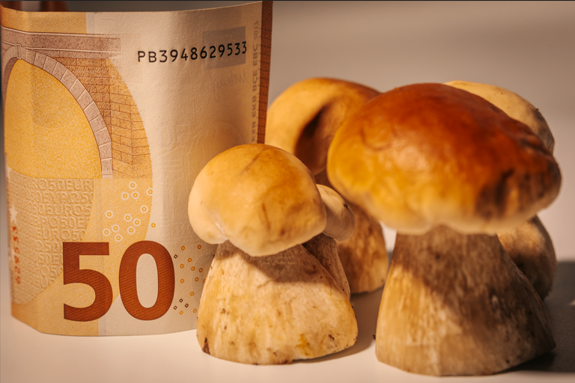
Mushroom cultivation:
Sustainability and Economic Benefits

Slide 34
Ideal for urban and small-scale farmers.
Creates jobs in farming, processing, and distribution.
Rapid income generation through quick mushroom cultivation.
Contributes to skill development in rural communities.
Generates additional income from Agrotourism and educational workshops.
Lower financial barriers enabling new and smaller farmers to enter the mushroom industry.
Rising domestic demand and export potential boost economic opportunities.
India is well-positioned to grow and export mushrooms, especially in regions like the Middle East, Europe, and the U.S.

Slide 35
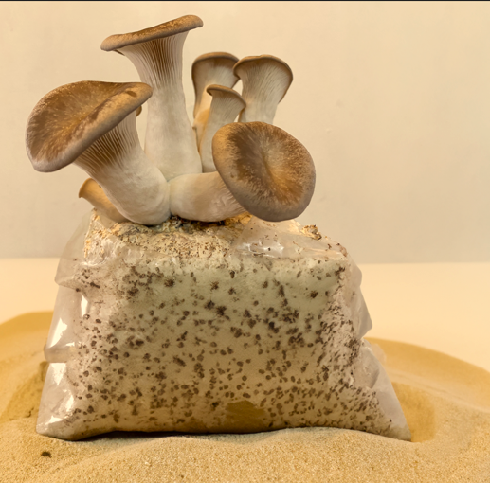
Mushroom cultivation:
Sustainability and Agricultural Benefits

Slide 36
Valuable in addressing food security and hunger.
Affordable source of high-quality nutrition
Convert agricultural waste into nutritious food.
By-products of mushroom cultivation improve soil health and fertility.
Wastes from mushroom cultivation are recycled back into other agricultural and farming systems.
Mushroom’s root structure captures and stores CO2, contributes to climate mitigation.
Offers a more sustainable alternative to monocropping.
Mushroom farms are space-efficient and minimize land degradation.

Slide 37
Top 10 locations for mushroom cultivation in India
1. Punjab
Particularly in areas: Ludhiana, Patiala, Fatehgarh Sahib, Rupnagar, and Jalandhar
Popular Varieties: Button mushrooms, oyster mushrooms.
2. Himachal Pradesh
Particularly in areas: Solan, Kullu, and Kangra
Popular Varieties: Button mushrooms, oyster mushrooms, shiitake mushrooms.
3. Maharashtra
Particularly in areas: Pune, Nashik, and Kolhapur.
Popular Varieties: Button mushrooms, oyster mushrooms, shiitake mushrooms.

Slide 38
4. Uttarakhand
Particularly in areas: Nainital and Mussoorie
Popular Varieties: Button mushrooms, oyster mushrooms, shiitake mushrooms.
5. Kerala
Particularly in areas: Kochi, Kottayam, Palakkad, Wayanad, Idukki, and Thrissur.
Popular Varieties: Button mushrooms and oyster mushrooms.
6. Karnataka
Particularly in areas: Bangalore, Mysore, and Tumkur.
Popular Varieties: Button mushrooms and oyster mushrooms.

Slide 39
Chop rice straw to 5 cm or smaller length.
7. West Bengal
Particularly in areas: Kolkata and Murshidabad
Popular Varieties: Button mushrooms and oyster mushrooms.
8. Chhattisgarh
Particularly in areas: Raipur and Bilaspur
Popular Varieties: Button mushrooms and oyster mushrooms.
9. Tamil Nadu
Particularly in areas: Coimbatore, Dindigul, and Erode
Popular Varieties: Button mushrooms and oyster mushrooms.
10. Bihar
Particularly in areas: Patna, Muzaffarpur, and Gaya
Popular Varieties: Button mushrooms and oyster mushrooms.

Slide 40
In a nut-shell
Mushroom cultivation in India holds significant potential for agricultural diversification, economic growth, and nutritional improvement. With a favorable climate and growing consumers, the country is well-positioned to expand its mushroom production. With continued investment in education, research, and infrastructure, mushroom cultivation can thrive, contributing to food security, economic development, and the promotion of sustainable farming practices.

Slide 41
Chop rice straw to 5 cm or smaller length.
References
1. https://icar.org.in/node/5830
2. https://blog.ffreedom.com/oyster-mushroom-farming/
3. https://gachwala.in/how-to-grow-oyster-mushrooms-a-step-by-step-guide-tips/
4. https://indiaagronet.com/indiaagronet/Mushroom_cultivation/oyster.htm
5. https://ccari.icar.gov.in/oystermushroom.pdf
6. https://www.iihr.res.in/cultivation-technology-oyster-mushroom
https://knowledge.desikheti.com/oyster-mushroom-farming-complete-guide-for-beginners/
https://justagriculture.in/files/newsletter/2021/november/62.%20Fundamental%20Cultivation%20Technology%20Of%20Oyster%20Mushroom.pdf
https://nios.ac.in/media/documents/vocational/mushroom_production_(revised)(618)/Lesson- 04.pdf

