Slide 1
Fundamentals of Remote sensing
Prepared By: Ms Afrin Zaidi, Ms Prisha PareekMr. Sayanta Ghosh

Slide 2
Table of Content
Basic concept of Remote sensing
Elements involved in Remote sensing
Type of Sensors
Basic concept of Electromagnetic Radiation
Electromagnetic spectrum
Interaction of electromagnetic radiation with atmosphere
Interaction of electromagnetic radiation with Earth surface
Platform & Type
Sensor’s Resolution
Application & Advantages of remote sensing

Slide 3
Basic concept of Remote sensing
What is Remote sensing?
Remote sensing are the art, science, and technology of obtaining reliable information about physical objects and the environment, through the process of recording, measuring and interpreting imagery and digital representations of energy patterns derived from non-contact sensor systems (Colwell, 1997).
Remote sensing system capture radiation in different wavelength reflected / emitted by the earth’s surface features and recorded it either directly on the film as in case of aerial photography or in digital medium used for generating the images.
It provides extensive and timely data on resources, methodologies, and the environment, facilitating efficient resource management and national development.

Slide 4
Elements involved in Remote sensing
Source of Illumination
Radiation and the Atmosphere
Interaction with the Earth elements
Recording of Energy by the Sensor
Transmission, Reception, and Processing

Slide 5
Elements involved in Remote sensing
Source of Illumination
Remote sensing requires an energy source, primarily the Sun, to provide electromagnetic radiation for capturing reflected light.
Radiation and the Atmosphere
Electromagnetic radiation interacts with the atmosphere while traveling to and from the target, undergoing scattering, absorption, and refraction, which modify its path and provide atmospheric data.
Interaction with the Earth elements
Once the energy makes it way to the target through the atmosphere, it interacts with the target depending upon the properties of both the target & radiation
Recording of Energy by the Sensor
Transmission, Reception, and Processing
A remote sensor detects, and records electromagnetic radiation scattered or emitted from a target, providing detailed spatial data on brightness across various wavelengths.
The energy recorded by the sensor has to be transmitted in electronic form, to a receiving and processing station where the data processed into an image.

Slide 6
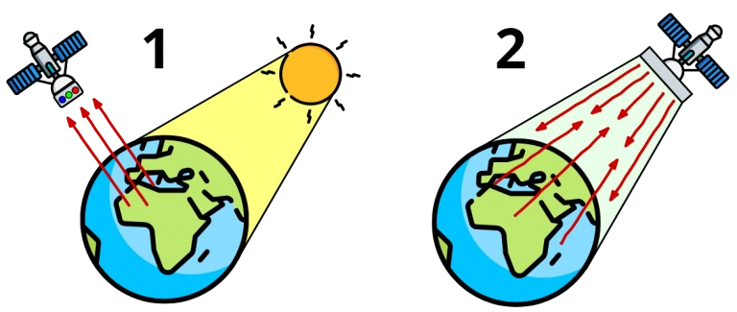
Type of Sensors
Source of Illumination
Passive Sensors
They detect natural energy(radiation) that is emitted or reflected by the object or scene being observed. Reflected sunlight is the most common source of radiation measured by passive sensors.
Active Sensors
They transmit their own signal and measure the energy that is reflected and transmitted back or scatter back from the target. For example, radar sonar. In general , they provide their own source of energy to illuminate the object which they observe.

Slide 7
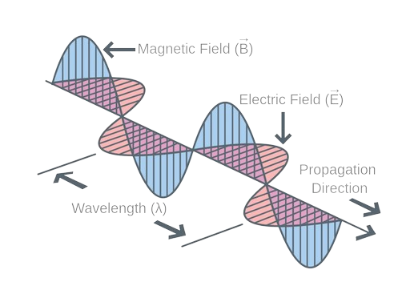
Basic concept of Electromagnetic Radiation
Electromagnetic radiation (EMR), also called as electromagnetic energy, and refers to all energy that moves with the velocity of light in the form of waves. The source of EMR is the subatomic vibration of photons and is measured in terms of wavelength.
Sun is the main source of EMR that travels through space in the form of waves that are either reflected or absorbed by the objects, mainly on account of the size of wavelength which is described by the distance of successive wave peaks and is represented by a Greek letter lambda.

Slide 8
Electromagnetic spectrum
The electromagnetic spectrum represents the complete range of electromagnetic radiation. The region of the spectrum with a shorter wavelength than the color violet is referred as ultraviolet radiation, and the region of the spectrum with a longer wavelength than the color red is referred to as infrared radiation.

Slide 9
Electromagnetic spectrum
Gamma rays (<0.3 Å) and X-rays (0.3–300 Å) are rarely utilized due to atmospheric opacity, with applications primarily limited to low-altitude aircraft observations or the study of airless planetary bodies such as the Moon. This spectral region is predominantly employed for detecting radioactive materials.
The Ultraviolet region (300 Å–0.4 µm) is primarily used for studying planetary atmospheres or airless surfaces due to atmospheric opacity at short wavelengths. An ultraviolet spectrometer on the Voyager spacecraft analyzed the composition and structure of the upper atmospheres of Jupiter, Saturn, and Uranus.
The Visible region (0.4–0.7 µm) plays a crucial role in remote sensing, receiving maximum solar illumination and being widely detectable by sensors. It constitutes a small portion of the electromagnetic spectrum and is the only region associated with color perception, encompassing the primary colors: blue, green, and red.

Slide 10
Electromagnetic spectrum
The Infrared region (0.4–1000 µm) is divided into reflected, thermal, and far-infrared sub-regions. Reflected infrared includes Near Infrared (NIR, 0.7–1.4 µm) and Short-Wave Infrared (SWIR, 1.4–3.0 µm). Thermal infrared consists of Mid Wave Infrared (MWIR, 3.0–8.0 µm) and Long Wave Infrared (LWIR, 8.0–15.0 µm). Far Infrared spans 15.0–1000 µm. Molecular rotation and vibration influence this region, which is utilized in remote sensing by imagers, spectrometers, radiometers, polarimeters, and lasers. Thermal infrared specifically provides surface temperature data.
The Microwave region (1 mm–1 m) operates down to a wavelength of 1 mm (300 GHz) and is primarily governed by molecular rotation at shorter wavelengths. It is widely used in microwave radiometry, spectroscopy, and radar systems.
The Radio wave region (>10 cm, <3 GHz) includes wavelengths exceeding 10 cm and is employed by active radio sensors such as imaging radars, altimeters, and sounders, as well as passive radiometers.

Slide 11
Interaction of electromagnetic radiation with atmosphere
Electromagnetic radiation travels through the Earth's atmosphere at nearly the speed of light, but interactions with atmospheric constituents alter its speed, intensity, direction, and spectral distribution. The atmosphere is not completely transparent to radiation; however, certain wavelengths exhibit good transmission, while others are absorbed. These interactions, known as atmospheric effects, impact remote sensing.
Refraction: Means the bending of light when it passes from one medium to another. Refraction occurs because the different density of medium to pass such as air and water constituent in the atmosphere and the speed of electromagnetic radiation is different in each medium.
Scattering: The multiple, reflections of electromagnetic waves by particles and surfaces. It is 'unpredictable.
Elastic scattering (no energy change) – Rayleigh, Mie, and non-selective scattering.
Inelastic scattering (energy change) – Compton and Raman scattering.
Atmospheric absorption: The atmosphere in the earth is not open for all electromagnetic radiations, some are absorbed by the constituents such as various gas molecules available in the atmosphere.
Attenuation: The absorption and scattering act to reduce the amount of radiation received by satellite and the combined effect of these two is called attenuation. Attenuation is the energy loss caused by the atmosphere.

Slide 12
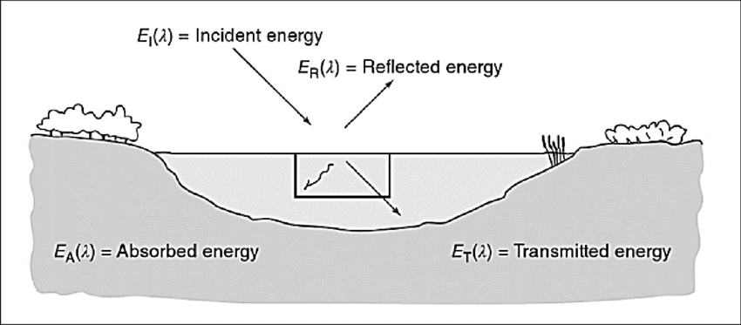
Interaction of electromagnetic radiation with Earth surface
When electromagnetic energy is incident on any given earth surface feature, 3 fundamental energy interactions with them i.e. reflected, absorbed and transmitted.
E_{I} (1) =E_{R} (1) + E_{A} (1) + E_{T}(1)
E_{R} (1) = E_{I} (1)-[E_{A} (1) + E_{T}(1) ]
E_{I}= Incident Energy
E_{R} = Reflected Energy
E_{A} = Absorbed Energy
E_{T} = Transmitted Energy
The proportions of reflected, absorbed, and transmitted energy vary by material type, condition, and wavelength, enabling feature distinction in images. Some features may appear similar in one spectral range but distinct in another. Since many remote sensing systems operate in reflected energy regions, understanding reflectance properties is crucial for feature identification.

Slide 13
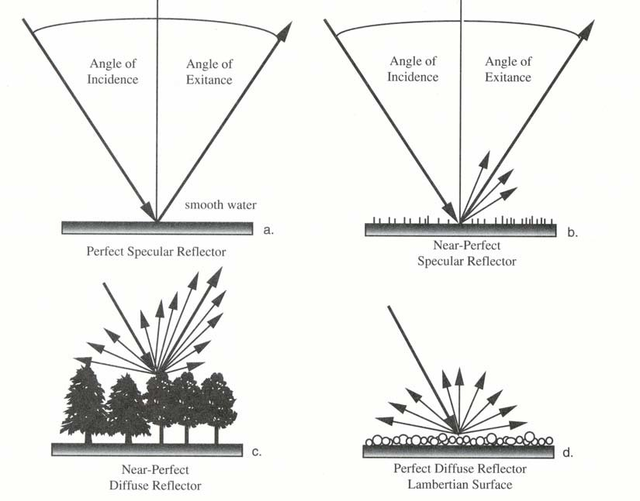
Interaction of electromagnetic radiation with Earth surface
Reflectance
Reflectance: It is a ratio of the reflected light spectrum to the incident light spectrum. The process by which a beam of particles or a wave in collision with an opaque surface may be deviated or reversed in direction.
Reflectance may be specular or diffuse. Specular reflectors are flat surfaces that apparently mirror like reflections, where the angle of reflection is equals to the angle of incidence such as calm water or very smooth surface. The diffuse or Lambertian reflectors are rough surfaces that reflect uniformly in all directions.
In Remote sensing these diffuse reflectance from the surface is most important because diffuse reflections contains spectral information or the 'color' of the reflecting surface, whereas specular reflection do not contains any color it appears bright or dark in the imagery

Slide 14
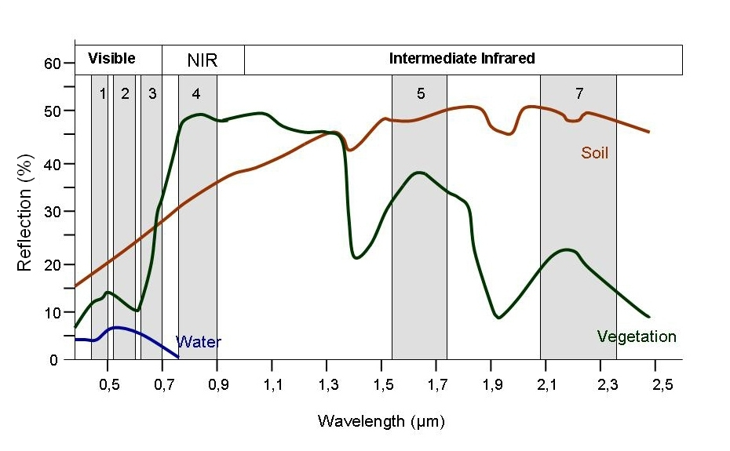
Interaction of electromagnetic radiation with Earth surface
Spectral Reflection Curve
The reflectance characteristics of earth surface features may be quantified by measuring the portion of incident energy that is reflected. This is measured as a function of wavelength called spectral reflectance.
A graph of the spectral reflectance of an object as a function of wavelength is termed as a spectral reflection curve:
The Graph shows reflection (%) versus wavelength (µm) for water, vegetation, and soil.
Vegetation: High reflectance in the Near-Infrared (NIR) region.
Soil: Greater reflectance in the Intermediate Infrared range.
Water: Primarily identified using Visible and NIR wavelengths due to low reflectance.

Slide 15
Interaction of electromagnetic radiation with Earth surface
Interaction of Electromagnetic Radiation with Soil:
Soil properties like moisture, texture, roughness, minerals, and organic matter affect reflectance. Coarse, sandy soils with low moisture have high reflectance, while fine-textured, poorly drained soils reflect less. Dry soils show the opposite trend. Coarse soils appear darker in imagery, and roughness or organic matter reduces reflectance. Iron oxide lowers reflectance in the visible spectrum.
Interaction of Electromagnetic Radiation with Vegetation:
Vegetation reflectance is influenced by leaf pigments (chlorophyll), structure, and moisture. Healthy plants appear green due to high absorption of blue and red light and strong reflection of green. The blue and red bands are chlorophyll absorption regions, and plant stress reduces chlorophyll production, lowering absorption. In the near-infrared (NIR) region, reflectance is determined by leaf structure, varying across species, making NIR useful for species differentiation and stress detection.
Healthy vegetation reflects 40-50% of incident NIR energy, with minimal absorption. Reflectance increases with leaf layers, peaking at about eight layers. Beyond 1.3 µm, vegetation primarily absorbs or reflects energy. Water absorption bands occur at 1.4, 1.9, and 2.7 µm, while peak reflectance occurs at 1.6 and 2.2 µm between these absorption bands.

Slide 16
Interaction of electromagnetic radiation with Earth surface
Interaction of Electromagnetic Radiation with water:
Water interacts with electromagnetic radiation in multiple ways. The water surface mainly produces specular reflection, while clear deep-water acts like a blackbody in the near-infrared by absorbing most of the energy. Suspended materials increase the overall reflectance, and higher chlorophyll concentrations decrease reflectance in the blue region while increasing it in the green, which remote sensing uses to monitor algae. Additionally, snow reflects strongly in the visible region but shows a sharp drop in the near-infrared, and the mid-infrared (SWIR) helps distinguish snow (low reflectance) from clouds (higher reflectance).

Slide 17
Platform & Type
Platform is stage to mount the camera or sensor to acquire the information about the target under investigation. Based on altitude above the earth surface, platform may be classified as, ground borne, airborne and spaceborne.
Type of Platform:
Ground-borne remote sensing uses sensors positioned close to the ground via tripods, buildings, handheld devices, or moving vehicles.
Spaceborne remote sensing involves sensors mounted on satellites in nearly circular orbits (eccentricity <0.01), offering high speed, a large field of view, and continuous global coverage.
Airborne remote sensing uses aircraft, previously pigeons, balloons, or kites, providing flexible altitude choices and timely data acquisition.

Slide 18
Sensor’s Resolution
Resolution refers to the resolving power of an optical system or sensor, measuring its ability to distinguish between spatially close or spectrally similar signals. It determines how well a sensor can separate closely spaced objects in an image or photograph and is defined by its capacity to render information at the smallest discretely separable unit.
Distance = Spatial resolution
Wavelength band = Spectral resolution
Radiation quantity = Radiometric resolution
Time = Temporal resolution

Slide 19
Sensor’s Resolution
Spatial resolution
This is the most common and refers to the size of the smallest object that can be distinguished in the image, often measured in meters per pixel.
Spectral resolution
Spectral resolution refers to the specific wavelength intervals in the electromagnetic spectrum that a sensor can record. The spectral resolution of a remote sensing instrument is determined by the bandwidths of the electromagnetic radiation in the channels it uses.
Radiometric resolution
The number of digital levels. (color) used to express the data collected by the sensor. Number of discrete levels into which a signal strength may be divided or quantization. In general, the greater the number of levels the greater the detail in information
Very High Resolution: <1 meter per pixel (e.g., 30cm resolution)
High Resolution: 1 to 5 meters per pixel
Medium Resolution: 5 to 30 meters per pixel
Low Resolution: >30 meters per pixel
Temporal resolution
Example: 6 bit data has 64 levels (0-63), 7 bit data has 128 levels (0-127). 8 bit has 256 levels (0-255)
It is a revisit period of the satellite over the same area or time between successive image acquisitions over same area. Temporal resolution is also called the receptivity of the satellite in the case of satellites. For example, IRS-1A/IB, IC/IDLISS-I and II has 22 days, LISS-III has 24 days. PAN has 5 days; LANDSAT MSS has 18:days, TM has 16 days: SPOT has 5/26 days.

Slide 20
Application & Advantages of remote sensing
Wide Area Coverage and Accessibility
Large-scale monitoring: Enables observation of vast and remote areas, inaccessible by traditional methods.
Accessibility: Provides data from difficult or hazardous locations, such as disaster-affected or mountainous regions.
Efficiency: Rapid data acquisition allows quick assessment and monitoring of changes.
Temporal and Spatial Resolution
Time-series analysis: Regular data collection enables tracking of environmental changes like deforestation, urbanization, and climate impact.
High spatial resolution: Advanced sensors capture detailed images for precise mapping and analysis.
Diverse Applications
Environmental Monitoring: Tracks deforestation, pollution, and climate change effects.
Agriculture: Assesses crop health, estimates yields, and identifies irrigation and fertilization needs.
Disaster Management: Provides real-time data for damage assessment and emergency response.
Infrastructure Monitoring: Aids in maintaining roads, bridges, and pipelines through proactive assessment.
Geological Surveying: Investigates Earth's geological features remotely without on-site exploration.
Urban Planning: Supports city development through image analysis and land-use planning.

Slide 21
Additional Recourses
https://epgp.inflibnet.ac.in/
https://www.usgs.gov/faqs/what-remote-sensing-and-what-it-used#:~:text=Remote%20sensing%20is%20the%20process,sense%22%20things%20about%20the%20Earth.
https://natural-resources.canada.ca/sites/nrcan/files/earthsciences/pdf/resource/tutor/fundam/pdf/fundamentals_e.pdf
https://www.nasa.gov/directorates/somd/space-communications-navigation-program/remote-sensing/
Jensen, John R. 2015. Introductory Digital Image Processing: A Remote Sensing Perspective. Pearson.
Lillesand, T. M., & Kiefer, R. W. Remote Sensing and Image Interpretation. Wiley, 2007.

