Slide 1
Biophilic Design Approach for Improved Performance
Sustainable Buildings
Nature, Quality of Life, Sustainable, Green
Ar. Prajna Aigal
Research Associate, Sustainable Buildings
The Energy and Resources Institute

Slide 2
What is “Biophilic”?
“The human tendency to interact or be closely associated with other forms of life in nature”
-Merriam Webster
Biophilic architecture seeks to connect people with nature within buildings and built spaces. It is based on the philosophy that humans have the innate tendency to connect with nature. It incorporates natural elements in the design to enhance the well-being of the occupants of the space in terms of health, happiness and overall quality of life.

Slide 3
Biophilic vs. Sustainable vs. Green
Biophilic | Sustainable | Green
Is based on the innate connection between human and nature | Is based on reducing the negative impacts on environmental, social and economical facets of a building throughout it’s life time | Is based on reducing the negative impacts on environmental facets of a building
Emphasis on Social Aspects
Emphasis on Environmental Aspects

Slide 4
Biophilic vs. Sustainable vs. Green
Sustainable Development
Environment
Social
Biophilic
Green
Economic
Sustainability

Slide 5
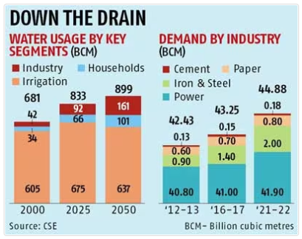
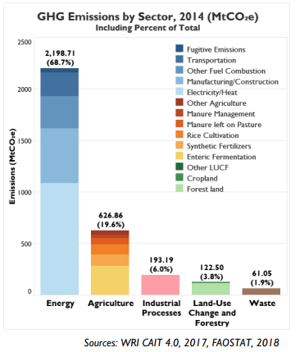
Why do we need “sustainable architecture”?

Slide 6
What all comprises biophilic design?
Environmental Features
Natural Patterns and Forms
Light and Space
Place-based Relationships
Connection with Nature
Characteristics of the natural world such as water features, sunlight, vegetation etc.
Using patterns and forms that are naturally found in nature such as shapes, motifs etc.
Using lighting to enhance the space especially natural lighting
Connection with local ecology and geographical features
Enhancing the inherent connection between humans and nature

Slide 7
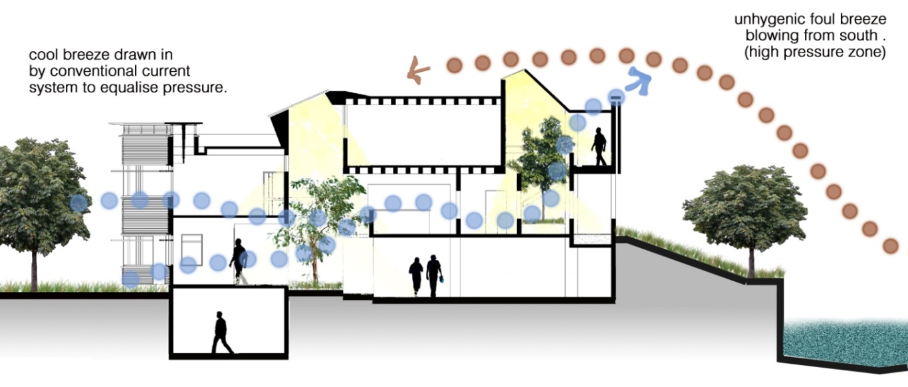
Integrating “biophilic design” into “biophilic architecture”
1
Provision of vegetative and water elements at regular intervals throughout the building
2
Provision of natural lighting and ventilation over artificial lighting and HVAC

Slide 8
Biophilic into Green
Types of Plants
Lighting Requirement
Types of Water Fixtures
Vegetative and Water Features
Lighting and Ventilation
Ventilation Requirement
Irrigation
Lighting and Ventilation Fixtures
Water Supply
CLIMATE

Slide 9
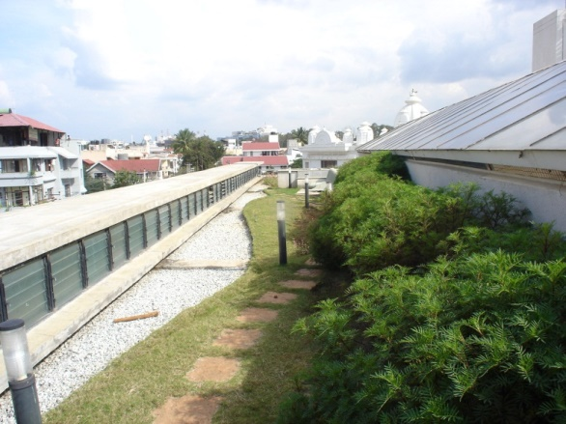
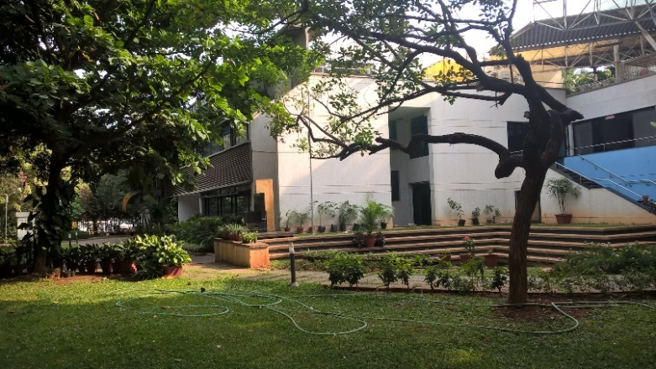
Biophilic into Green
Use of plants that are native to the location and/or adaptive to the climate
Types of Plants
Vegetative and Water Features

Slide 10
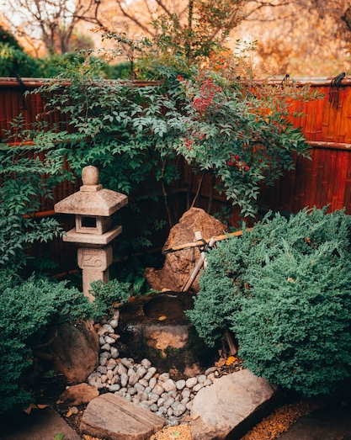
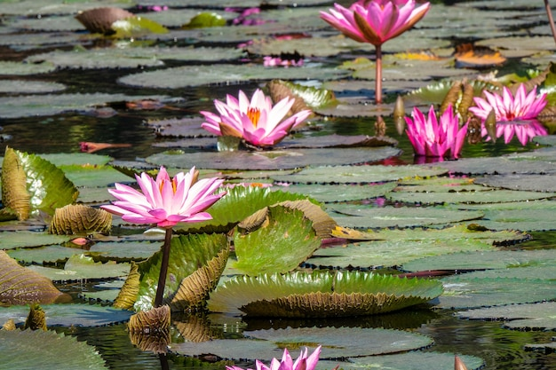
Biophilic into Green
Types of Water Fixtures
Water features that are efficient in terms of water usage and losses
Vegetative and Water Features
Smaller sizes
Recycling water
Use of plants to reduce evaporation
Shading to reduce evaporation

Slide 11
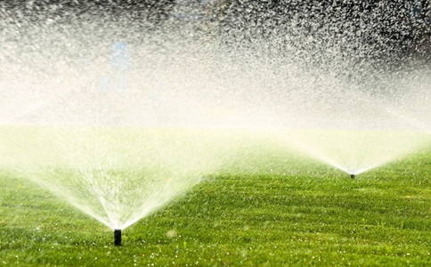
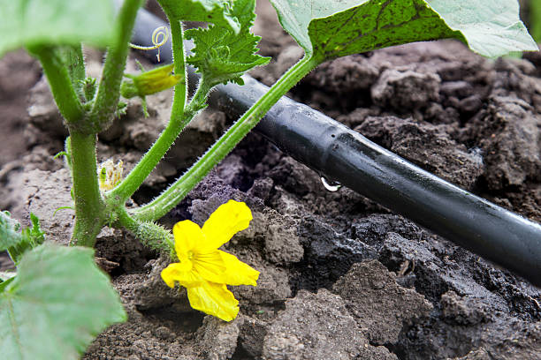
Biophilic into Green
Irrigation
Use of efficient irrigation systems such as sprinklers or drip irrigation
Vegetative and Water Features

Slide 12
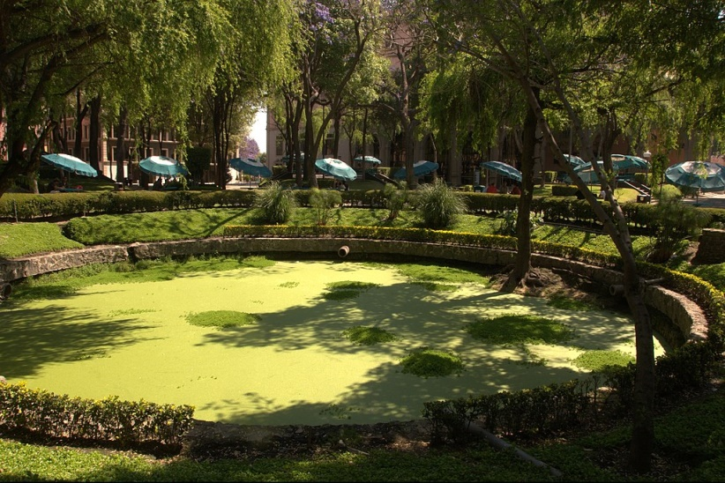
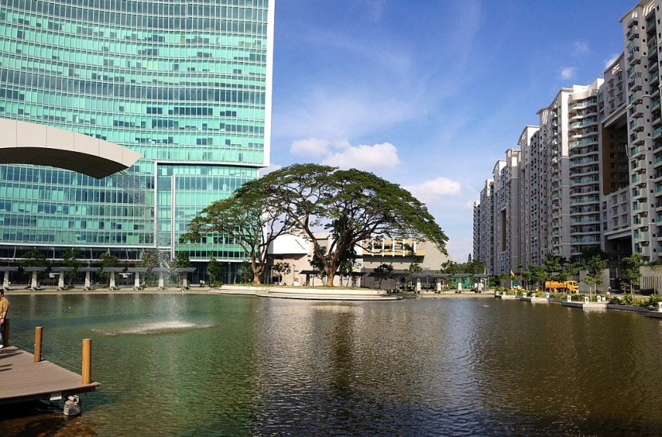
Biophilic into Green
Biophilic into Green
Water Supply
Use of harvested rain water or treated sewage water in irrigation and water features
Vegetative and Water Features

Slide 13
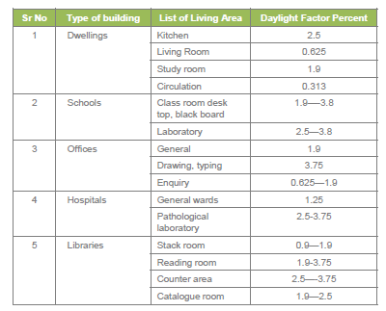
Biophilic into Green
Lighting Requirement
Amount of lighting and type of lighting required as per the function of the space
Daylight Factor Requirements for Different Types of Spaces as per SP 41
Lighting and Ventilation

Slide 14
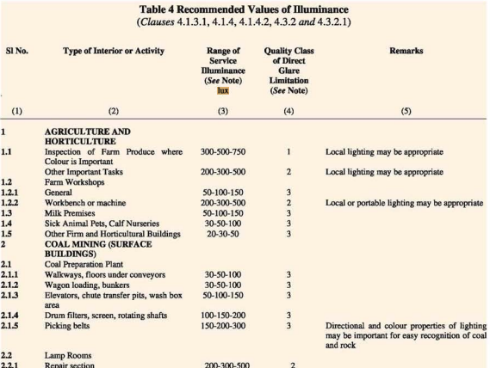
Biophilic into Green
Lighting Requirement
Amount of lighting and type of lighting required as per the function of the space
Illumination Level Requirements for Different Types of Spaces as per NBC
As per Table 4, under section “Lighting and Natural Ventilation” Vol. 2, NBC 2016
Lighting and Ventilation

Slide 15
Biophilic into Green
Ventilation Requirement
Amount of ventilation and type of ventilation required as per the function of the space
Desirable wind speeds for thermal comfort conditions as per NBC
Dry bulb temperature (deg C) | Relative humidity (%)
 | 30 | 40 | 50 | 60 | 70 | 80 | 90
28 | * | * | * | * | * | * | *
29 | * | * | * | * | * | 0.06 | 0.19
30 | * | * | * | 0.06 | 0.24 | 0.53 | 0.85
31 | * | 0.06 | 0.24 | 0.53 | 1.04 | 1.47 | 2.10
32 | 0.20 | 0.46 | 0.94 | 1.59 | 2.26 | 3.04 | **
33 | 0.77 | 1.36 | 2.12 | 3.00 | ** | ** | **
34 | 1.85 | 2.72 | ** | ** | ** | ** | **
35 | 3.20 | ** | ** | ** | ** | ** | **
As per Table 9, under section “Lighting and Natural Ventilation” Vol. 2, NBC 2016
Lighting and Ventilation

Slide 16
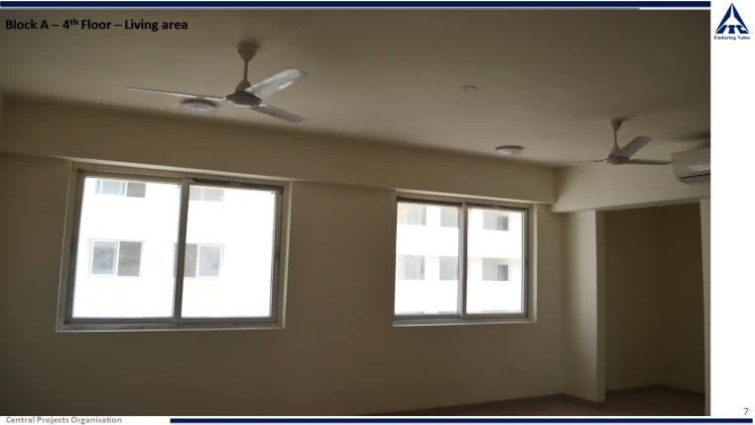
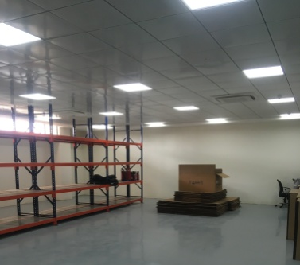
Biophilic into Green
Lighting and Ventilation Fixtures
Use of energy efficient lighting and ventilation devices in the space
Lighting and Ventilation

Slide 17
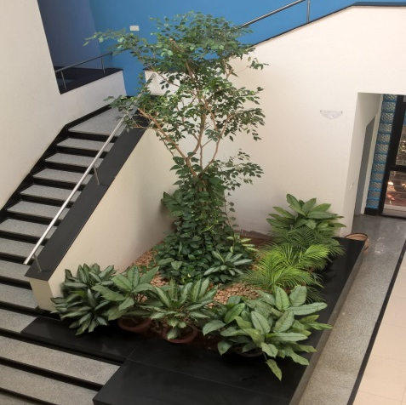
Benefits of biophilic and green architecture
1
User satisfaction and increased productivity
2
Reduction in use of comfort appliances; in turn reducing energy/electricity required for their operation
3
Efficient use of water; in turn conservation of water
4
Improved air quality of the space
5
Increasing the amount of vegetation in the area; in turn reducing the urban heat island effect
Biophilic Architecture

Slide 18
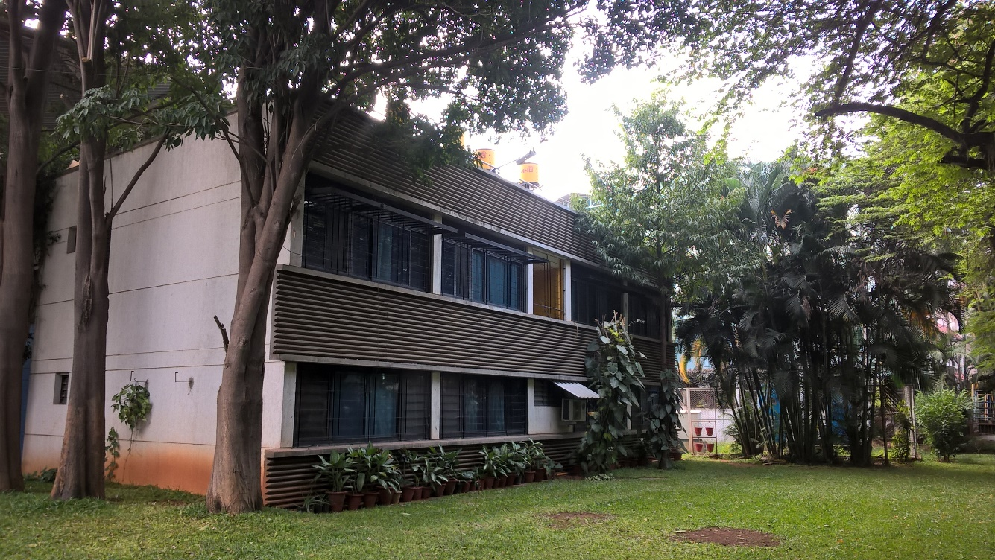
Any questions?
Thank you!
Ar. Prajna Aigal
Research Associate, Sustainable Buildings
The Energy and Resources Institute
prajna.aigal@teri.res.in

Slide 19
References
https://www.merriam-webster.com/dictionary/biophilic#:~:text=bio%C2%B7%E2%80%8Bphil%C2%B7%E2%80%8Bic,forms%20of%20life%20in%20nature
https://www.render4tomorrow.com/what-is-biophilic-architecture
https://www.re-thinkingthefuture.com/architectural-community/a6416-how-is-biomimicry-different-from-biophilia/
https://theconstructor.org/architecture/principles-of-biophilic-design/564602/
https://www.british-assessment.co.uk/whats-the-difference-between-green-and-sustainable-buildings/
https://www.climatelinks.org/sites/default/files/asset/document/India%20GHG%20Emissions%20Factsheet%20FINAL.pdf
https://www.business-standard.com/article/companies/soft-drinks-power-among-high-water-guzzling-industries-114111302124_1.html

