Slide 1
Module 2: Basics of Geographic Information System
Prepared By: Ms Afrin Zaidi, Ms Prisha PareekMr. Sayanta Ghosh

Slide 2
Table of Content:
Introduction to GIS
Examples of Real – life Application
Elements of GIS
Components of GIS
A List of Commercial and Free and Open-Source GIS Software
Types of Spatial Data, Working with Raster and Vector Data
Applications of GIS
Demonstration of an Open-source Software - QGIS
Additional Resources

Slide 3
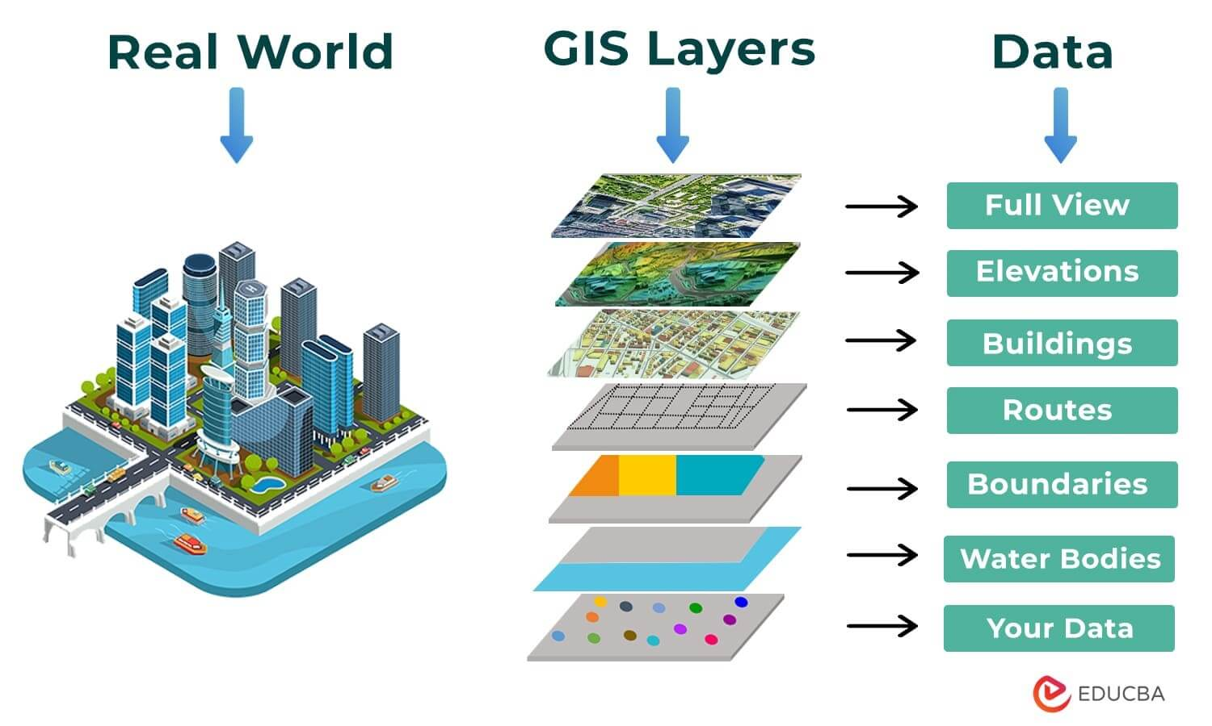
Introduction to GIS
GIS (Geographic Information System) is a framework for
Gathering
Managing
Analyzing
Manipulating
data related to geographic locations on Earth's surface.
It helps visualize, interpret, and understand patterns, relationships, and trends in data through maps and 3D models.

Slide 4
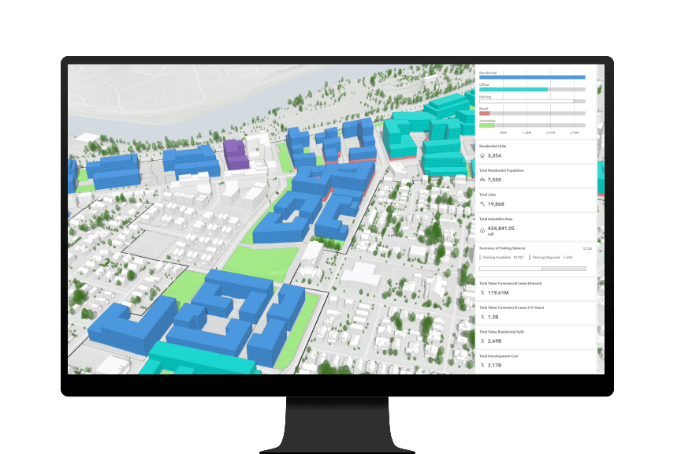
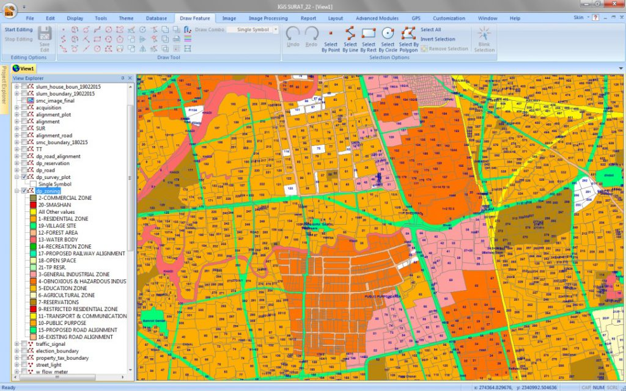
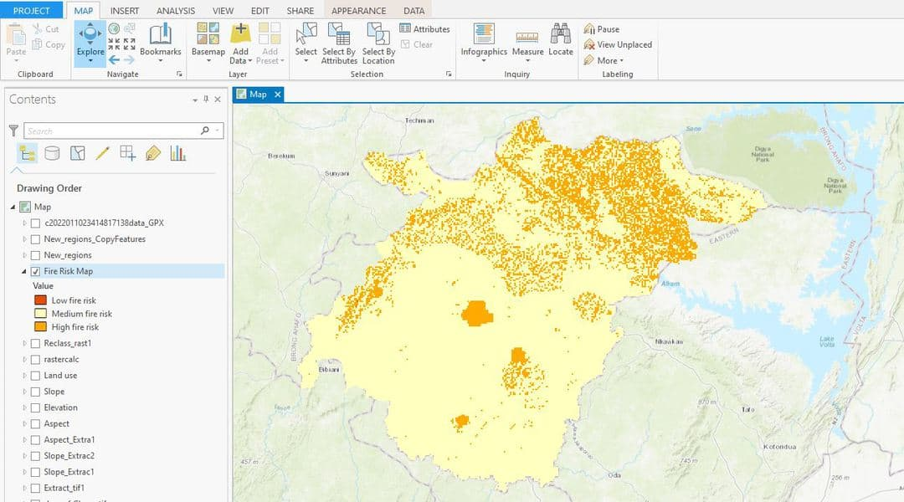
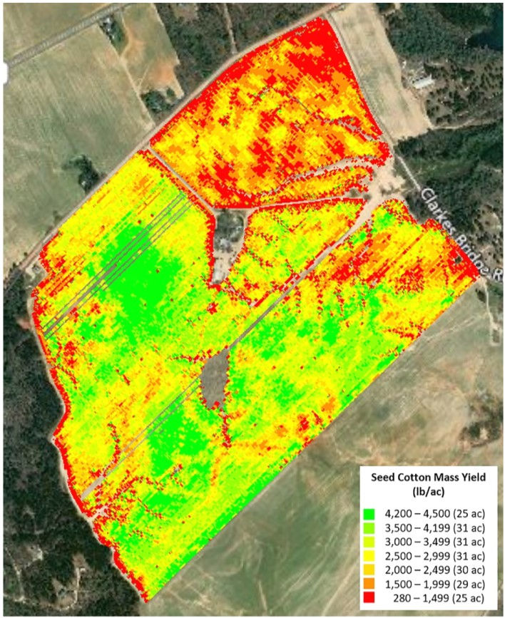
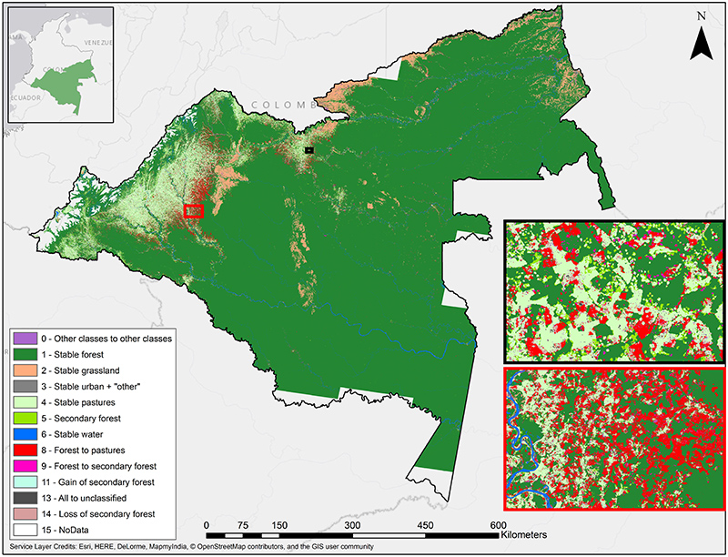
Examples of Real – life Application
Urban Planning – Zoning, infrastructure design
Transportation – Traffic analysis, route planning
Disaster Management – Flood prediction, evacuation planning
Agriculture – Crop monitoring, soil analysis
Environmental Management – Deforestation tracking, pollution control

Slide 5
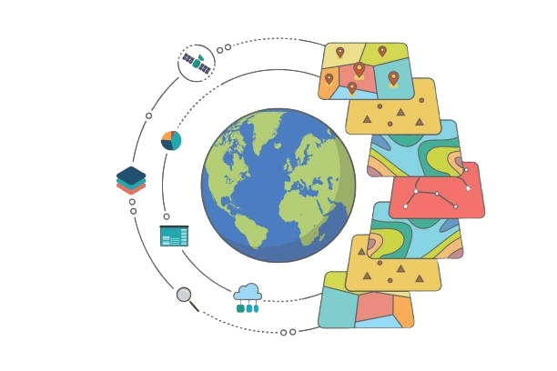
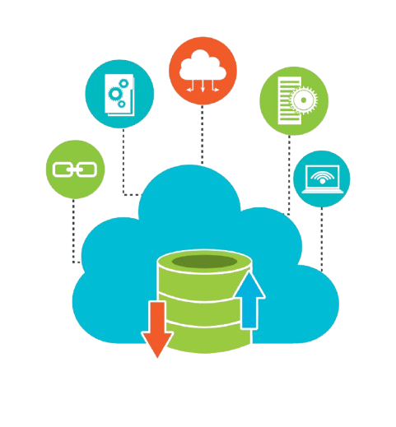
Elements of GIS
Geospatial Data
Data Acquisition
Data Management
Data Analysis
Data Visualization
Data Exploration

Slide 6
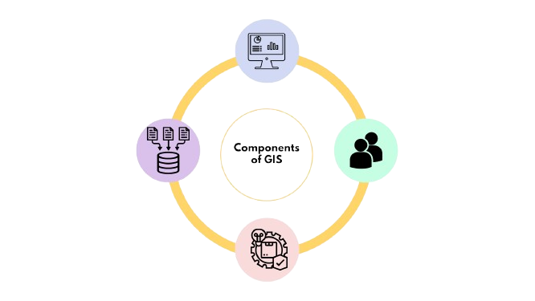
GIS hardware includes computers for processing, storing, and managing data; printers and plotters for reports and maps; digitizers and scanners for spatial data; and GPS and mobile devices for fieldwork.
Components of GIS
GIS software, either commercial or open source, includes programs and applications to be executed by a computer for data management, data analysis, data display, and other tasks.
HARDWARE
GIS professionals define the purpose and objectives for using GIS and interpret and present the results.
SOFTWARE
PEOPLE
GIS operations has GIS Data as its foundation, including
• spatial data (e.g., geographic features, locations) and
• attribute data (e.g., characteristics, and attributes
associated with spatial data)
DATA

Slide 7
A List of Commercial and Free and Open-Source GIS Software
Commercial | Free and Open- Source
Environmental Systems Research Institute (Esri) (http://www.esri.com/ ): ArcGIS | Quantum GIS Project (http://www.qgis.org/ ): QGIS
Autodesk Inc. (http://www.autodesk.com/ ): AutoCAD Map3D and Autodesk Geospatial | SAGA User Group (http://www.saga-gis.org ): SAGA GIS
Bentley Systems, Inc. (http://www.bentley.com/ ): Bentley Map | Open-Source Geospatial Foundation (http://grass.osgeo.org/ ): GRASS
Blue Marble (http://www.bluemarblegeo.com/ ): Global Mapper | Center for Spatial Data Science, University of Chicago (http://spatial.uchicago.edu/ ): GeoDa
Pitney Bowes (http://www.mapinfo.com/ ): MapInfo | MapWindow GIS Project (http://mapwindow.org/ ): MapWindow
Intergraph/Hexagon Geospatial (http://www.intergraph.com/ ): GeoMedia | International Institute for Aerospace Survey and Earth Sciences, the Netherlands (http://www.itc.nl/ilwis/ ): ILWIS

Slide 8
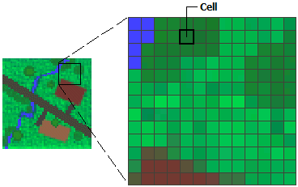
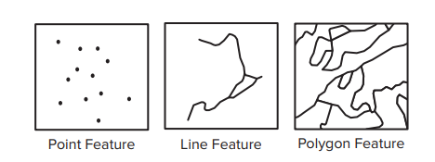
Types of Spatial Data, Working with Raster and Vector Data
The vector data model uses points, lines, and polygons to represent spatial features with a clear spatial location and boundary such as streams, land parcels, and vegetation stands. Each feature is assigned an ID so that it can be associated with its attributes.
The raster data model uses a grid and grid cells to represent spatial features: point features are represented by single cells, line features by sequences of neighboring cells, and polygon features by collections of contiguous cells. The cell value corresponds to the attribute of the spatial feature at the cell location. Raster data are ideal for continuous features such as elevation and precipitation
Raster
Vector

Slide 9
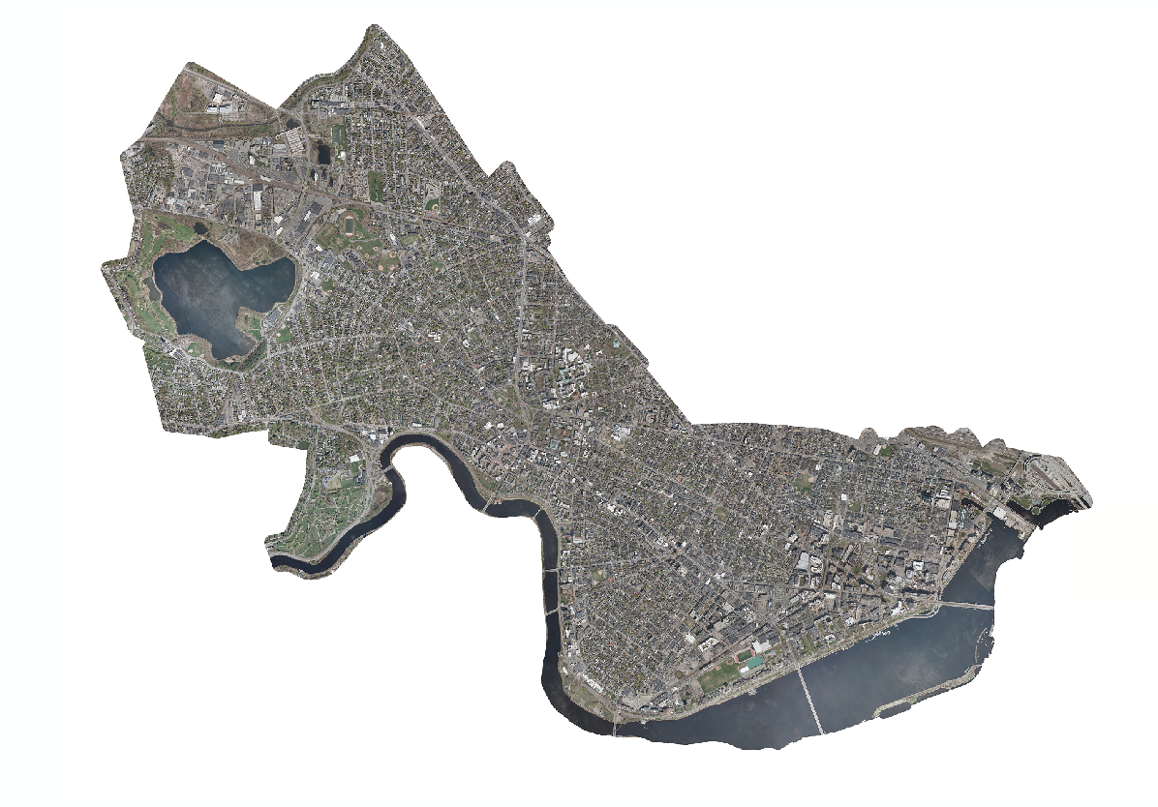
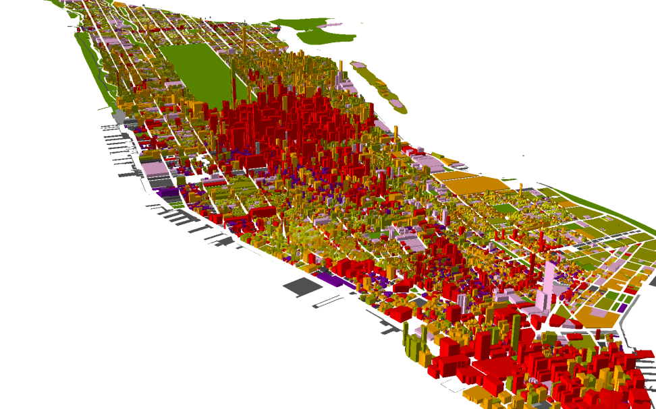
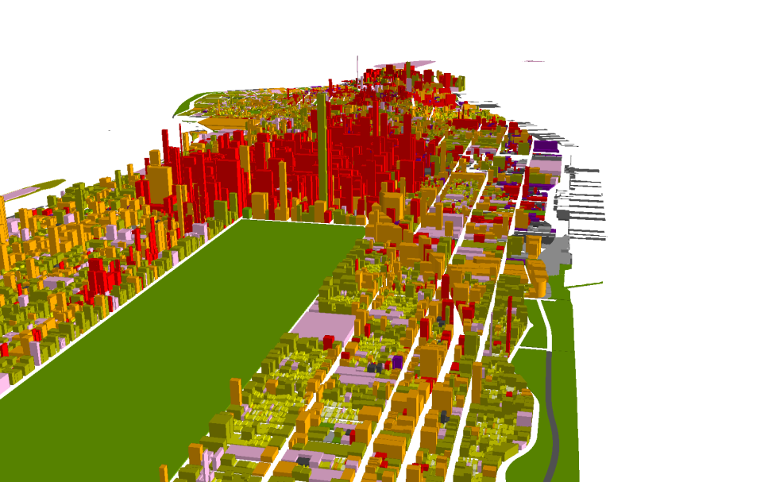
Applications of GIS
View Imagery
Create 3D models
City of Cambridge Aerial Photograph, April 2010

Slide 10
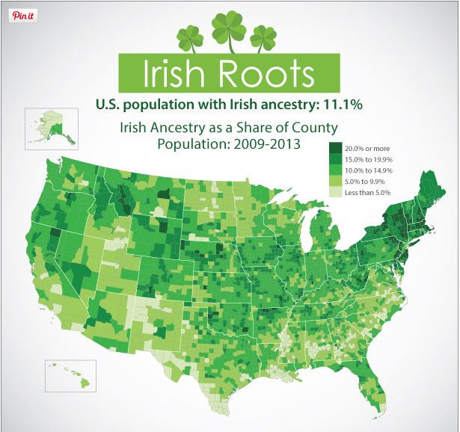
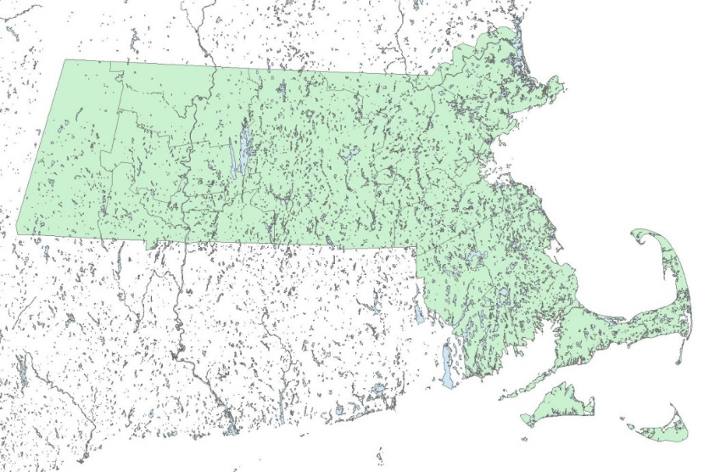
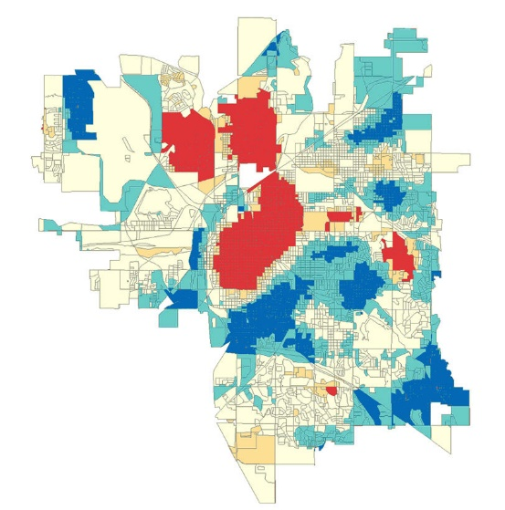
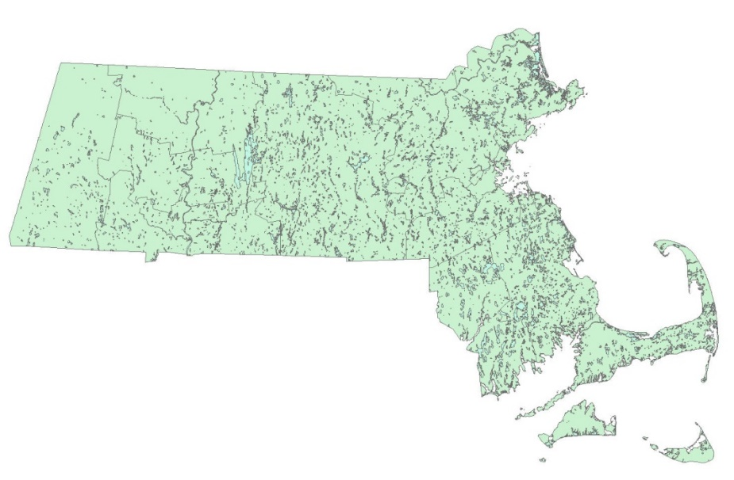
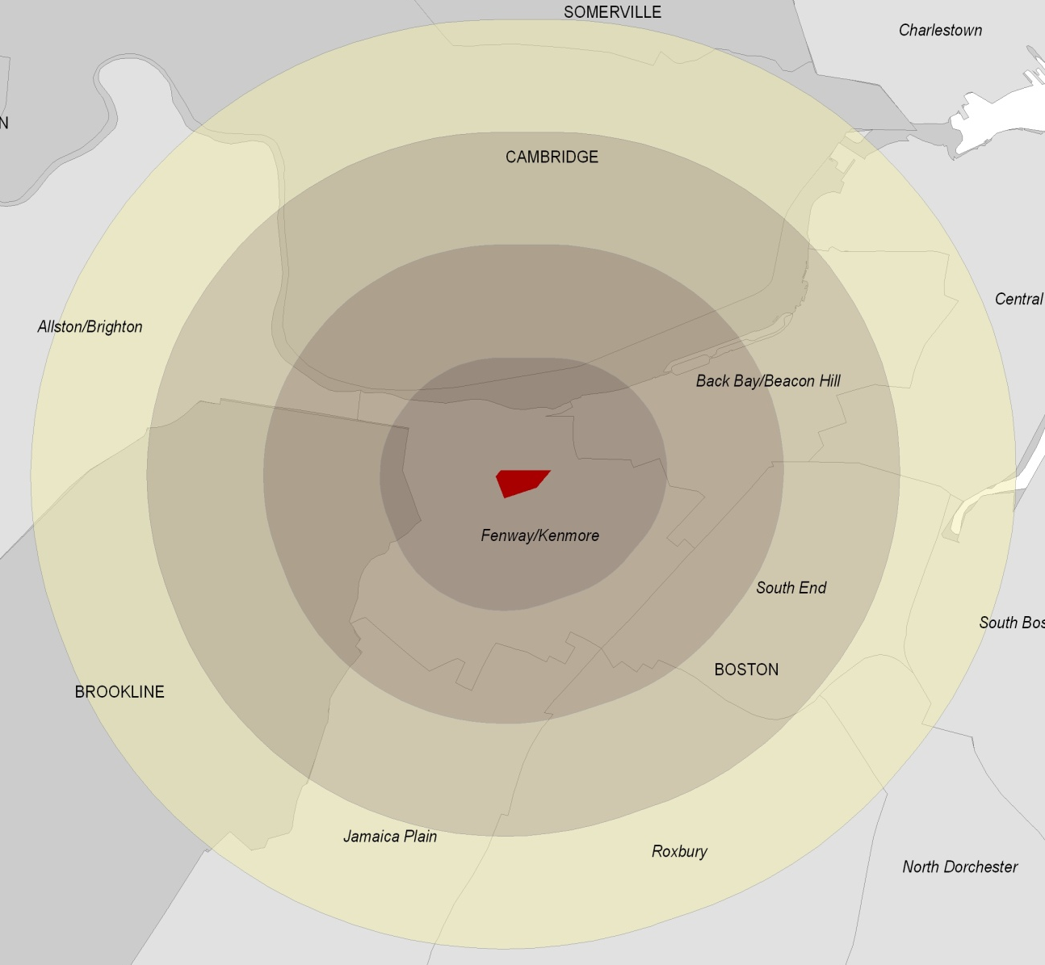
Applications of GIS
Create Maps
Conduct Analysis
Analyze values (Spatial Statistics)
Edit geometry (Clip tool)
Create data (Buffer tool)
Courtesy of US Census. Image is in the public domain.
Crime hotspots © Scott & Warmerdam

Slide 11
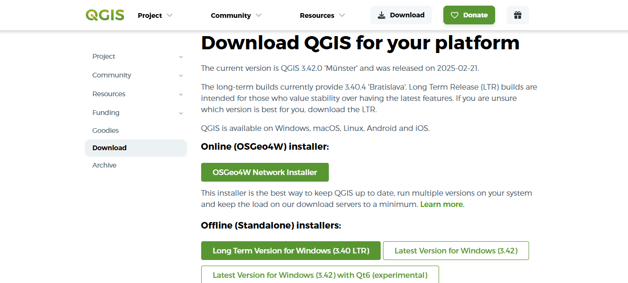
Demonstration of an Open-source Software - QGIS
Step 1: Download the standalone offline version of QGIS
Step 2: Once Downloaded, Hit the run button to start the installation process and follow the prompts. There is no need to install the data sets suggested by QGIS.
https://qgis.org/download/

Slide 12
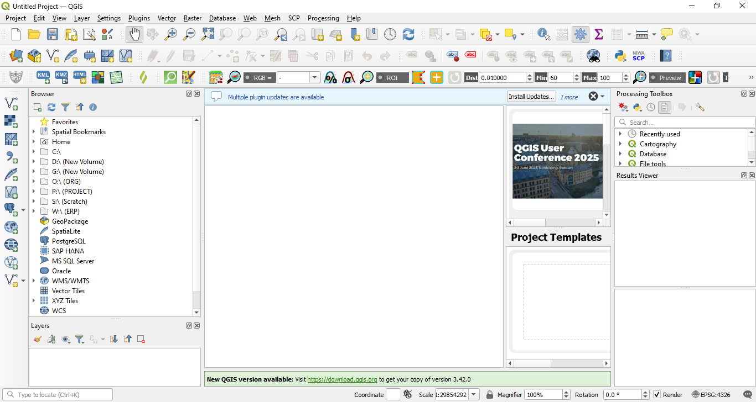
The elements Identified in the figure are:
Layers List / Browser Panel
Toolbars
Map canvas
Status bar
Side Toolbar
Locator bar
2
1
3
5
4
6

Slide 13
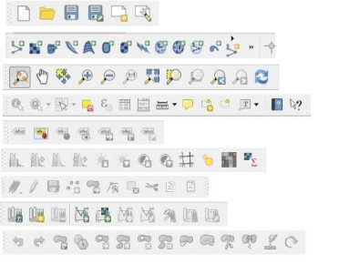
Key Functions
File
Manage Layers (Vertical)
Map Navigation
Attributes
Label
Raster
Editing/Digitizing
GRASS Plugin
Advanced Digitization

Slide 14
Additional Resources
ArcGIS case Study - 1-Extend Crime Analysis with ArcGIS Spatial Statistics Tools
QGIS User Guide - https://docs.qgis.org/3.40/en/docs/user_manual/index.html
QGIS Introduction to GIS - https://docs.qgis.org/3.40/en/docs/gentle_gis_introduction/index.html
ESRI Introduction to GIS - https://www.esri.com/en-us/what-is-gis/overview#:~:text=Geographic%20information%20system(s)%2C,what%20things%20are%20like%20there).

